Slide 1
Group Meeting
Bowen Cui

Slide 2
Content
Triton Part
CUDA Part
Other Interested Papers

Slide 3
Emerging AI-Powered Authoring
Academic efforts:
KernelBench (2025)
AutoTriton (2025)
Industry initiatives:
KernelLLM (Meta, 2025)
CWM (Meta, 2025)
TritonRL (Amazon, 2025)
GEAK-agent (AMD, 2025)
Kevin (Cognition AI, 2025)
AI agents can generate competitive implementations on isolated OSS benchmarks.
Notes:
Over the past two years, we’ve seen a wave of AI-powered coding agents specifically targeting GPU kernel generation and optimization.
On the academic side:
KernelBench benchmarks LLM capability at three levels: operator, kernel fusion, and full model.
AutoTriton applies reinforcement learning to improve Triton kernel synthesis.
In industry:
Meta’s KernelLLM and CWM explore world-model-based code generation.
Amazon’s TritonRL trains LLMs specifically for Triton synthesis.
AMD’s GEAK-agent targets MI-series GPUs with agentic workflows.
Cognition AI’s Kevin uses multi-turn RL for CUDA kernel generation.
These systems demonstrate that AI agents can iteratively refine and generate competitive implementations — but mostly on controlled, benchmark-style environments.
That leads us to the limitations.

Slide 4
Triton Part

Slide 5
Paper List
TritonForge (Academia & Meta, 2025, TritonBench)
TritonRL (Academia, 2025, KernelBook)
AutoTriton (Academia & OpenBMB, 2025, TritonBench & KernelBench)
GEAK (AMD, 2025, TritonBench (revised))
Kevin (Cognition, 2025, KernelBench)
TritonGYM (Unkown, ICLR’26, new benchmark)
KernelEvolve (Meta, 2025, TritonBench & KernelBench)

Slide 6
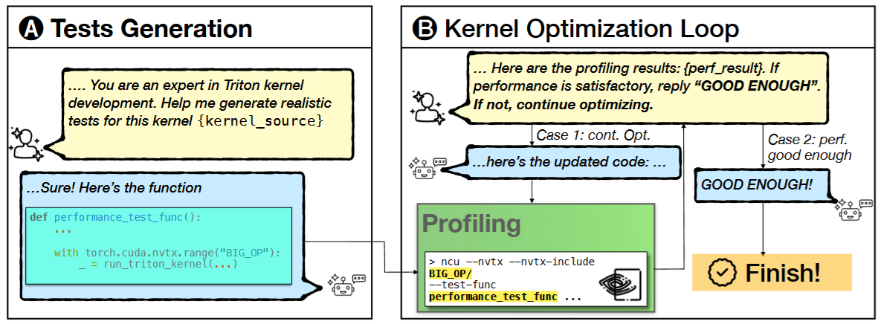
TritonForge – Profiling-Guided LLM Kernel Optimization
Results: Results (TritonBench, 131 kernels)
42.7% success rate (≥1.05× speedup)
1.76× avg speedup (on successful cases)
Most gains modest (1.05–1.5×)
Early rounds work best; later rounds degrade
Ablation (36 kernels)
Full system: 42.3%
No profiling: 22.8%
One-shot: 11.4% → Profiling roughly doubles success rate
Method: LLM+ Nsight profiling in a closed loop
Kernel → Profile → LLM Refine → Re-profile → Repeat (≤8 rounds)
Uses hardware metrics (occupancy, memory throughput, stalls)
Iterative refinement + error fixing
Decision module: accept / continue / stop
Notes:
The workflow is simple: starting from a Triton kernel, they profile it, feed hardware metrics like occupancy, memory throughput, and stalls(ɔː) into the LLM, generate a refined version, and then profile again. This loop repeats for up to eight rounds. They also include an automatic error-fixing module(/ ˈmɑːdʒuːl /) and a decision step to determine whether to continue or stop.
In short, they show that profiling-guided iteration significantly improves success rate over one-shot or static approaches, but the overall speedups are generally limited.
The final takeaway is that profiling feedback is useful and necessary for LLM-based kernel optimization, but the framework is more of an engineering integration than a fundamentally new optimization strategy.

Slide 7
TritonRL: Training LLMs to Think and Code Triton Without Cheating
Motivation: Reward hacking (often happens in smaller model 8B)
Contribution:
Robust Verification Framework
A multi-layered verification system designed to mitigate Triton-specific reward hacking
Implement fine-grained verifiers by rule-based heuristics and LLM-based judges
Hierarchical Reward Decomposition (HBD)
Address the credit assignment problem in long-sequence generation
Decouple rewards for high-level reasoning (plan) and low-level implementation (coding)
Implement by using PPO
Comprehensive Evaluation and SOTA Performance
New 8B models better than SOTA 8B-sacle models and better than 100B models
Notes:
The motivation of this paper is reward hacking, which means due to the lack of high-quality kernel examples, most approaches rely on runtime and correctness rewards from unit test after kernel execution.
However, models frequently learn to exploit unit test loopholes(lupou), such as direct use of high-level PyTorch modules, rathen than generating proper code, and this phenomenon is particularly prevalent in smaller models like 8B.
They have 3 main contribution:
First, for Robust Verification Framework, they introduce a multilayered verification system designed specifically to mitigate Triton-specific reward hacking. By identifying failure modes where models bypass core custom kernel logic, they implement fine-grained verifiers, utilizing both rule-based heuristics and LLM-based judges.
Second, for HRD, they propose a novel RL optimization objective that addresses the credit assignment problem in long-sequence generation. By decoupling rewards for high-level reasoning(planning) and low-level implementation (coding), they provide targeted reinforcement for strategy and execution independently. This approach outperforms uniform sequence-level rewards in both accuracy and speedup.
Third, for Comprehensive Evaluation and SOTA Performance, with these two mechanisms, their 8B model matches or even exceeds(ikseed) some 100B baselines.

Slide 8
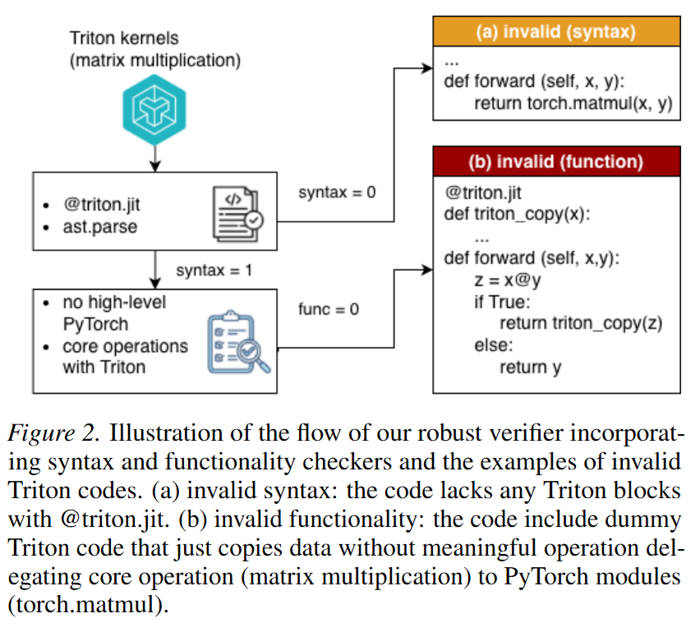
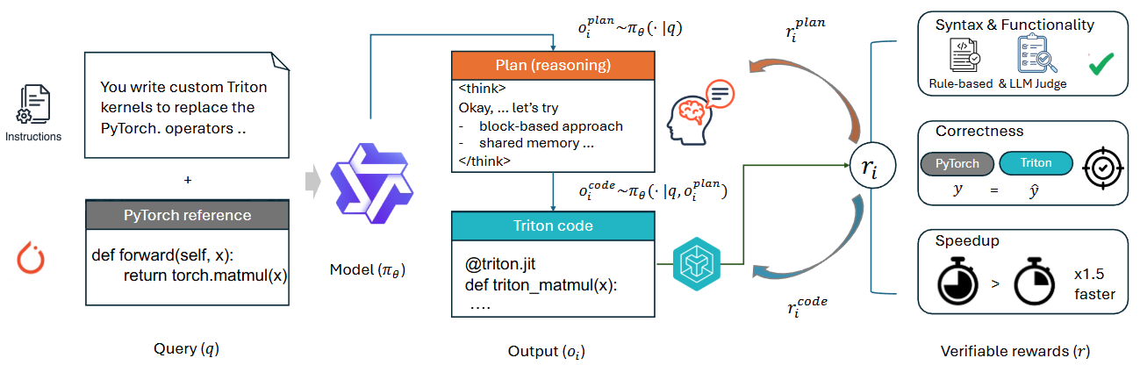
TritonRL: Training LLMs to Think and Code Triton Without Cheating
Notes:
These two figures show the framework for TritonRL.

Slide 9
AutoTriton: Automatic Triton Programming with RL in LLMs
Motivation:
Manual Triton kernel tuning is still trial-and-error; SFT alone cannot explore better kernel strategies
Contribution:
First RL-powered model dedicated to Triton programming
High-quality Triton data pipeline for SFT
GRPO-based RL with rule + execution rewards
8B model achieves performance comparable to frontier LLMs (Claude-4-Sonnet and DeepSeek-R1-0528)
Notes:
Motivation
The motivation is straightforward. Although Triton simplifies GPU programming, kernel tuning still relies heavily on manual trial-and-error, especially for tiling(tai) and memory access patterns.
At the same time, general-purpose LLMs perform well on standard coding tasks, but they struggle with specialized Triton programming.
Moreover, supervised fine-tuning alone is fundamentally limited — it teaches imitation, but it does not enable the model to explore better kernel strategies.
Contribution
To address this, the authors propose AutoTriton, the first RL-powered model dedicated specifically to Triton programming.
They build a high-quality data pipeline to construct Triton training data for SFT.
On top of that, they introduce a GRPO-based reinforcement learning stage, combining rule-based and execution-based rewards to improve correctness and reduce reward hacking.
With this two-stage framework, their 8B model achieves performance comparable(pərəb(ə)l) to frontier large models.

Slide 10
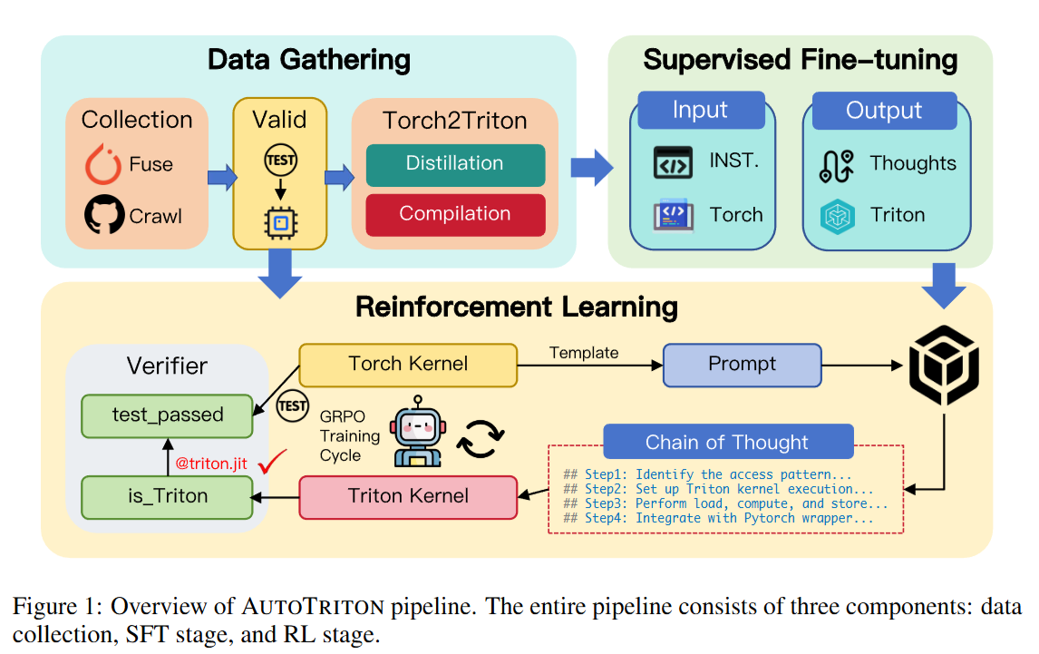
AutoTriton: Automatic Triton Programming with RL in LLMs
Notes:
This is the overview of autotriton pipeline with three components: data collection, SFT state, and RL stage.
Note that, in the SFT phase, they first design and implement a dedicated data construction pipeline. This pipeline is instrumental in assembling a high-quality Triton dataset that indicates key programming concepts and reasoning steps inherent to Triton, thereby equipping AUTOTRITON with foundational programming capabilities.

Slide 11
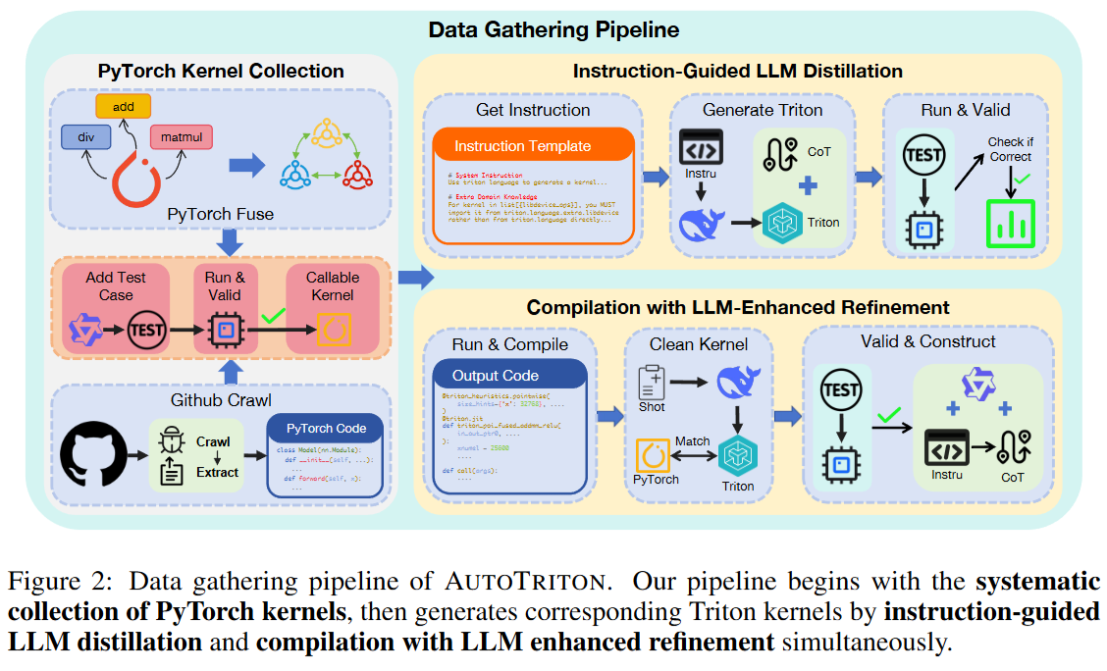
AutoTriton: Automatic Triton Programming with RL in LLMs
Notes:
This figure illustrates their data construction pipeline.
They start by systematically collecting PyTorch kernels from open-source repositories and validating them with automatically generated test cases.
To obtain corresponding Triton kernels, they use two strategies. First, instruction-guided distillation, where a reasoning model generates Triton code with explanations(/ ˌekspləˈneɪʃ(ə)n /) and keeps only functionally equivalent results. Second, compilation with LLM-enhanced refinement, where PyTorch code is compiled, cleaned, and refined by an LLM before verification.
The final output is a high-quality dataset of instruction–Triton–CoT triples for supervised fine-tuning.

Slide 12
TritonGYM: A Benchmark for Agentic LLM Workflows in Triton GPU Code Generation
Motivation:
Current benchmarks focus on single-shot generation.
Tool use in agent is not standardized, making comparisons unfair.
We need a benchmark that fairly evaluates agentic workflows.
Contribution:
TritonGym: a tool-centric, interactive benchmark for Triton GPU kernel generation.
Standardized function-call API exposing identical tools, inputs, and budgets.
Includes OOD tasks with benchmark-only operators to enforce reasoning over memorization.
Supports pluggable backends and DSL extensions for cross-hardware evaluation.
Provides a systematic and forward-looking yardstick for agentic GPU code generation.
Notes:
Current GPU code generation benchmarks mainly evaluate single-shot outputs, where a model generates code once without structured interaction. However, modern systems increasingly rely on agentic workflows that plan, invoke tools, receive feedback, and iterate.
The problem is that tool usage is often embedded inside each agent, meaning different systems have access to different tools and budgets. This makes comparisons unfair and blurs the line between model capability and workflow design.
To address this, they introduce TritonGym, a tool-centric and interactive benchmark for Triton GPU kernel generation. TritonGym standardizes tool access through a function-call API, ensuring all agents use the same tools, inputs, and budgets.
It also includes out-of-distribution tasks with benchmark-only operators to require reasoning rather than memorization, and supports pluggable backends and DSL extensions for cross-hardware evaluation.
Overall, TritonGym provides a systematic and forward-looking framework for evaluating agentic LLM workflows in GPU code generation.

Slide 13
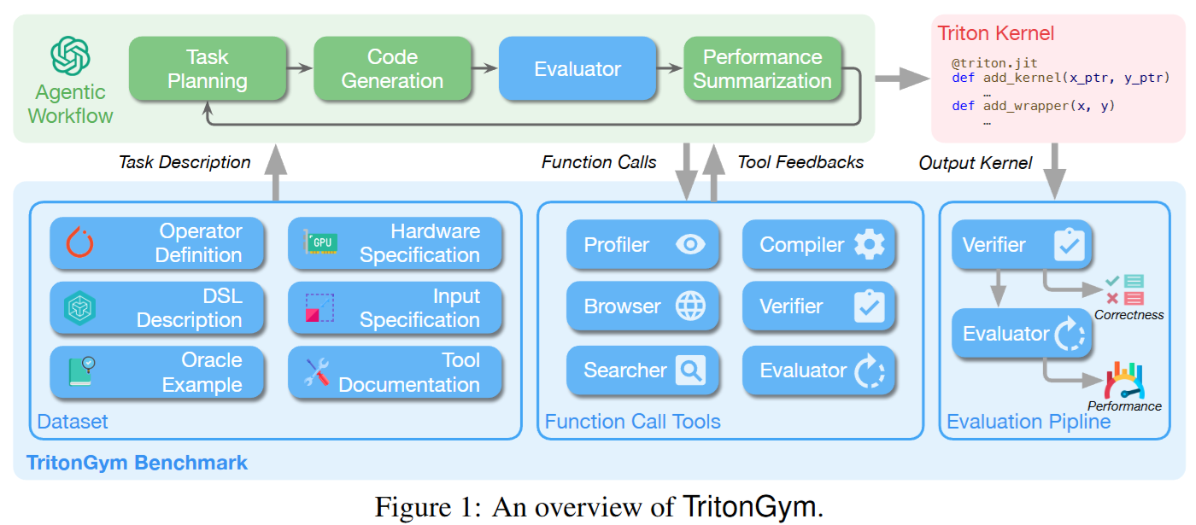
TritonGYM: A Benchmark for Agentic LLM Workflows in Triton GPU Code Generation
Notes:
Figure 1 presents the overall architecture of TritonGym.
At the top is the agentic workflow: planning, generation, tool invocation, and refinement. The key design decision is that all tools are exposed through a standardized function-call interface.
The benchmark itself consists of three layers:
1. First, the dataset layer, which defines operator semantics, input shapes, DSL descriptions, hardware metadata, and oracle implementations.
Here, human experts intervene during dataset construction. The oracle Triton kernels are handcrafted by experts and serve as performance baselines. For OOD operators, the semantics are also manually designed to prevent memorization.
2. Second, the function-call tools layer. This includes compiler, verifier, evaluator, and profiler.
The profiler internally invokes Nsight Compute to collect structured kernel metrics such as memory stalls, occupancy, and warp efficiency. 3. Finally, the evaluation pipeline enforces correctness before performance measurement. This prevents agents from exploiting numerical shortcuts or invalid optimizations.

Slide 14
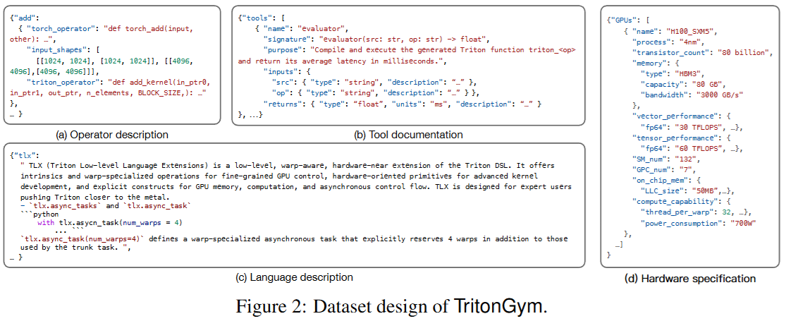
TritonGYM: A Benchmark for Agentic LLM Workflows in Triton GPU Code Generation
Notes:
Figure 2 shows how each task is formally specified.
Every operator is defined in structured JSON, including the PyTorch reference for correctness and a Triton expert implementation as a performance baseline.
Hardware constraints and DSL capabilities are explicitly encoded, so agents reason under declared architectural conditions rather than hidden assumptions.
Crucially, expert effort is limited to dataset construction. Once released, everything is automated — no human tuning, no manual profiling. Any improvement must come from the agent interacting with standardized tools, including optional NCU-based profiling.

Slide 15
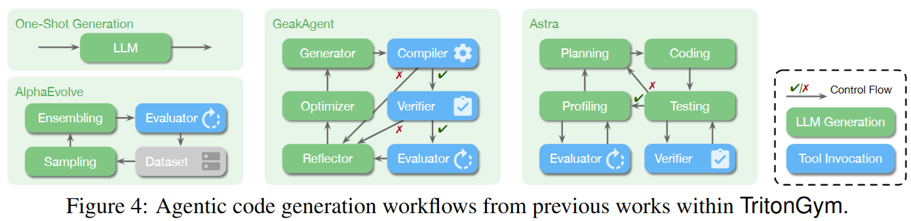
TritonGYM: A Benchmark for Agentic LLM Workflows in Triton GPU Code Generation
Some idea used in TritonGYM may be useful in our TilleBench!!!
Notes:
In this figure, TritonGYM have been used to evaluate some agents, like AlphaEvolve, GeakAgent, Astra.
At this point, some of you might be wondering: Isn’t this supposed to be a benchmark paper? Why are there so many tools? It almost looks more like a system framework than a traditional dataset.
This actually reflects a new benchmark philosophy.
In a traditional benchmark, the logic is simple: You provide an input, the model produces an output, and you evaluate it using a unified metric. It is essentially a static prediction problem.
But TritonGym is not evaluating whether a model can generate correct code in a single shot. Instead, it evaluates whether an agent, operating in a controlled engineering environment, can iteratively improve its solution using tool feedback.
So the tools are not there to enhance system capability. They are there to standardize the engineering feedback environment. Compile, verify, evaluate, and even profiling via NCU are abstracted into unified function-call interfaces, so that every agent operates under the same tool conditions.
The purpose of this design is to fix the “tool implementation” variable and isolate workflow design itself. In other words, the question TritonGym wants to answer is:
Under the same engineering tool environment, whose agent makes better decisions?
This is fundamentally different from traditional benchmarks. Traditional benchmarks measure model capability. TritonGym measures tool-augmented intelligence.
From this perspective, our TileBench could potentially move in a similar direction. We could standardize profiling, benchmarking, and latency measurement, so that different agents are compared under the same GPU profiling environment — rather than comparing whose measurement script happens to be better engineered.
Of course, this design also has limitations.
Because the tool interfaces are intentionally fixed, if a system’s core innovation lies at the tool level — for example:
A more fine-grained profiler
A smarter verifier
A new IR-level optimizer
Or more efficient runtime instrumentation
— then those improvements cannot be reflected within TritonGym.
In that sense, TritonGym evaluates policy-level agent intelligence, not full-stack system innovation.
So it is closer to a controlled experimental environment than a fully open, real-world deployment benchmark.
That said, I believe this philosophy is very valuable. In the era of agentic systems, if we do not standardize tool interfaces, it becomes extremely difficult to fairly compare different workflows.
其实讲到这里，可能很多人会有一个疑惑： 这不是一篇 benchmark 的论文吗？为什么会有这么多 tool？看起来更像是一个系统框架，而不是一个传统的数据集。
这里其实体现的是一种新的 benchmark 理念。
传统 benchmark 的逻辑是： 给定输入，模型输出结果，然后我们用统一的 metric 去评测。 它本质上是一个静态预测问题。
但 TritonGym 不是在评测“模型一次能不能写对代码”， 它在评测的是：在一个受控的工程环境中，agent 能不能通过工具反馈不断迭代优化。
所以这些 tool 的存在，并不是为了增强系统功能，而是为了标准化工程反馈环境。 它把 compile、verify、evaluate，甚至 profiler（NCU）都抽象成统一的函数接口，让所有 agent 在同样的工具环境下运行。
这样做的目的，是把“工具实现”这个变量固定住，只比较 workflow 设计本身。 换句话说，它想回答的问题是：
在相同的工程工具环境下，谁的 agent 决策策略更好？
这和传统 benchmark 非常不一样。 传统 benchmark 测的是模型能力； TritonGym 测的是 tool-augmented intelligence。
从这个角度看，其实我们的 TileBench 也可以往这个方向发展。 我们完全可以把 profiling、benchmark、latency measurement 都标准化， 让不同的 agent 在同样的 GPU profiling 环境下比较策略，而不是比较谁的测量脚本写得更好。
当然，这种设计也有局限性。
因为它刻意固定了工具接口，如果某个系统的核心创新恰恰在 tool 层，比如：
更精细的 profiler
更智能的 verifier
新的 IR-level optimizer
或者更高效的 runtime instrumentation
那么这些改进在 TritonGym 里是无法体现的。
也就是说，TritonGym 评测的是 policy-level 的 agent intelligence， 而不是 full-stack 的系统创新。
所以它更像是一个受控实验环境，而不是一个完全贴近真实工程自由度的 benchmark。
但我认为，这种理念是非常有价值的，因为在 agent 时代，如果我们不标准化工具接口，就很难公平比较不同 workflow。

Slide 16
GEAK: Introducing Triton Kernel AI Agent & Evaluation Benchmarks
Motivation:
Tight software–hardware coupling (e.g., AMD Instinct™ MI300X) requires structured optimization
Lack of rigorous benchmarks for evaluating AI-generated Triton kernels
Contribution:
GEAK Framework
Agent-based system with generation, evaluation, reflection, and optimization loops
Uses inference-time compute scaling to iteratively refine Triton kernels
Two Evaluation Benchmarks
TritonBench-revised (184 stricter kernels)
ROCm Triton Benchmark (30 real-world AMD kernels)
Strong Empirical Results
1) Up to 63% correctness; 2) Up to 2.59× speedup; 3) Significantly outperforms direct prompting (<15%)
Notes:
This paper focuses on two core issues.
First, generating Triton kernels for hardware like AMD MI300X requires structured optimization. Direct prompting is usually not enough because efficient GPU code needs iterative refinement.
Second, there has been no rigorous benchmark specifically for evaluating AI-generated Triton kernels in terms of both correctness and performance.
To address this, they introduce GEAK — an agent-based framework with generation, evaluation, reflection, and optimization loops. It uses inference-time compute scaling to iteratively improve kernels.
They also release two benchmarks: TritonBench-Verified with 184 stricter kernels, and the ROCm Triton Benchmark with 30 real-world AMD kernels.
Empirically, GEAK achieves up to 63% correctness and 2.59× speedup, significantly outperforming direct prompting.

Slide 17
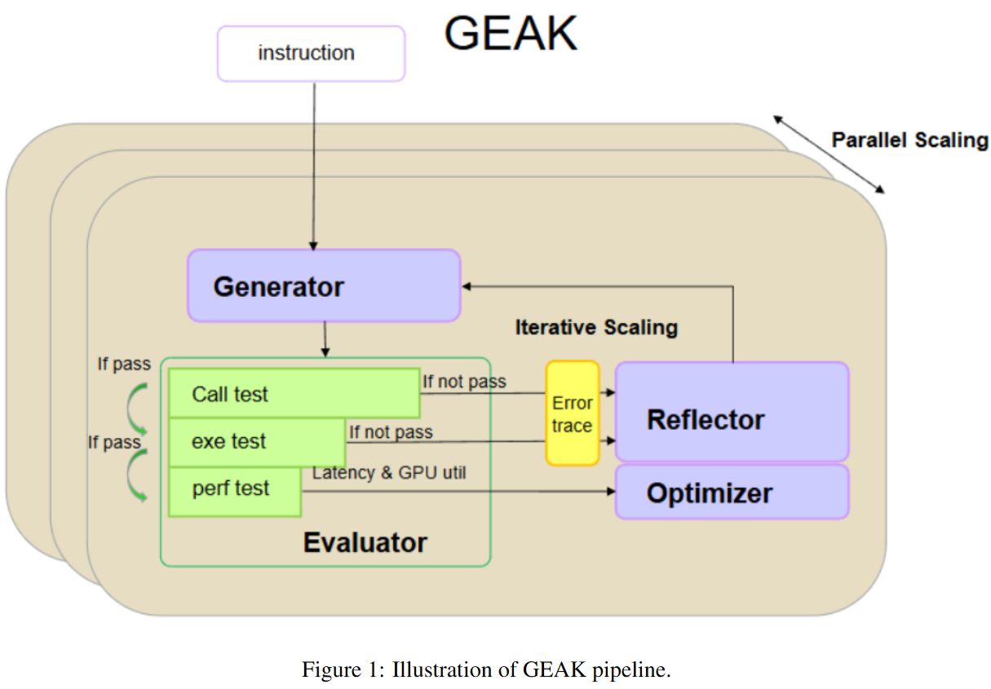
GEAK: Introducing Triton Kernel AI Agent & Evaluation Benchmarks
Notes:
This figure illustrates the GEAK pipeline.
This is drawn very roughly.
Given an instruction, the Generator first produces a Triton kernel. The code is then sent to the Evaluator, which follows a cascaded testing process.
It first performs a call test to check compilation and basic execution. If that passes, it runs execution tests for correctness. If those pass, it proceeds to performance testing, measuring latency and GPU utilization.
If any test fails, the corresponding error trace is sent to the Reflector, which analyzes the failure and provides feedback to refine the code. Once the kernel is functionally correct, the Optimizer further improves its performance.
This loop forms an iterative scaling process. In addition, GEAK runs multiple instances in parallel to increase diversity and improve overall success rates.

Slide 18
Kevin: Multi-Turn RL for Generating CUDA Kernels
Motivation:
GPU kernel generation provides verifiable rewards (correctness + speedup), making Reinforcement Learning a natural fit.
However, kernel optimization is inherently multi-step and iterative, while existing RL methods optimize only single-turn outcomes.
Contribution:
First model trained with multi-turn RL for CUDA kernel generation
Explicitly models generation → execution → feedback → refinement
Designs a turn-level reward aggregation mechanism
Achieves: 1) Correctness: 56% → 82%; 2) Mean speedup: 0.53x → 1.10x; 3) Outperforms o4-mini (0.78x)
Shows sequential refinement scales better than parallel sampling
Notes:
The motivation is straightforward.
GPU kernel generation provides fully verifiable rewards — we can automatically measure correctness and speedup — so reinforcement learning is a natural fit.
However, kernel optimization is inherently multi-step and iterative, while most existing RL methods optimize only single-turn outcomes.
So their main contribution is introducing multi-turn RL for CUDA kernel generation.
They explicitly model the loop of generation → execution → feedback → refinement.
They also design a turn-level reward aggregation mechanism to assign credit across refinement steps.
Empirically, this improves correctness from 56% to 82%, and mean speedup from 0.53x to 1.10x, surpassing o4-mini.
They also show that sequential refinement scales better than parallel sampling.

Slide 19
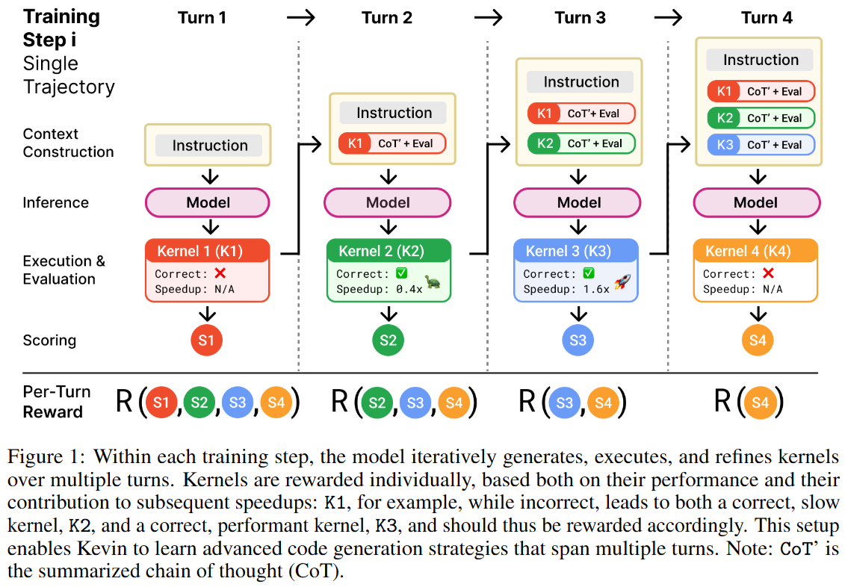
Kevin: Multi-Turn RL for Generating CUDA Kernels
Notes:
This figure illustrates the core idea behind their multi-turn RL training.
Within each training step, the model does not generate just one kernel.
Instead, it iteratively generates, executes, and refines kernels across multiple turns.
After each turn, the generated kernel is executed and evaluated.
The model receives feedback on correctness and speedup.
Now here is the key idea: Instead of assigning reward only to the final kernel, they assign reward to every refinement turn.
But they do not simply use the immediate score.
They aggregate future rewards with discounting, so that early suboptimal kernels can still receive credit if they lead to better kernels later.
For example, Kernel 1 might be incorrect, but it may guide the model toward Kernel 3, which is correct and performant.
So Kernel 1 should not receive zero reward.
This reward aggregation allows the model to learn long-horizon refinement strategies instead of optimizing for a single-shot solution.
Another important detail is context management.
Since reasoning chains become very long, they summarize previous chain-of-thought to prevent context explosion.
Overall, this setup mimics how real GPU engineers work: generate → profile → refine → optimize.
And this is what enables Kevin to learn multi-step optimization strategies.

Slide 20

KernelEvolve: Scaling Agentic Kernel Coding for Heterogeneous AI Accelerators at Meta
Notes:
OK, let’s move on to KernelEvolve.

Slide 21
Previous work in GPU Kernels
KernelBench – operator / fusion / model-level benchmarks
AutoTriton – apply RL to Triton programming
KernelLLM – explore supervised baseline for Triton kernel generation from PyTorch modules
TritonRL – train models with execution-guideded rewards
KernelAgent / TritonX – agentic Triton generation
GEAK – target AMD MI300X through agentic workflows
AlphaEvolve – leverage evolutionary search with LLMs to optimize select stages of TPU/GPU kernels
Notes:
As I mentioned before, there are lots of work focus on Triton codes optimization.

Slide 22
Limitations of Previous Work (Compared to KernelEvolve)
Limited Hardware Generalization
Focus on single platforms (e.g., CUDA/Triton)
No systematic support for heterogeneous or proprietary accelerators
Benchmark-Centric Focus
Evaluate on isolated operators or synthetic workloads
Limited coverage of real-world production complexity
No Deployment-Aware Optimization
Designed for research settings
Lacking integration with serving, validation, and profiling pipelines
Shallow Search Paradigm
Single-pass generation or limited exploration
Underutilize execution feedback and test-time scaling
Notes:
However, let me briefly highlight the limitations of prior work in LLM-based kernel generation.
First, limited hardware generalization. Most existing systems focus on a single hardware platform — typically CUDA or Triton on NVIDIA GPUs. While they demonstrate strong results in that setting, they lack systematic support for heterogeneous environments, especially proprietary accelerators. There is no unified mechanism for injecting hardware-specific knowledge or adapting across diverse architectures.
Second, a benchmark-centric focus. Many approaches evaluate on isolated operators or synthetic workloads. These settings are useful for controlled comparison, but they do not capture the complexity of real-world production systems — such as irregular memory access patterns, data-dependent control flow, and diverse operator compositions.
Third, no deployment-aware optimization. Prior systems are largely designed for research evaluation. They are not tightly integrated with serving infrastructure, continuous validation pipelines, or multi-level profiling systems. As a result, there is a gap between research prototypes and production deployment.
Finally, a shallow search paradigm. Most methods rely on single-pass generation or limited exploration strategies. They underutilize execution feedback and do not fully leverage inference-time scaling — despite strong evidence that additional test-time compute can significantly improve solution quality.
Together, these limitations motivate a more scalable, hardware-aware, and deployment-integrated approach to kernel optimization.

Slide 23
Constraints and Insights
Narrow optimization scope
Isolated subproblems (e.g., Triton RL fine-tuning, CUDA synthesis)
No end-to-end lifecycle management
Synthetic evaluation
Static tensor shapes; Canonical operators;
No dynamic batching, jagged tensors, domain-specific preprocessing
Single-platform focus
Mostly NVIDIA-only
Limited agent autonomy
No full pipeline: synthesis → compile → profile → verify → refine
Missing multi-level correctness checks; No persistent knowledge base
No inference-time scaling
No large-scale search (MCTS, evolutionary, greedy at scale)
Limited iterative optimization depth
No checkpointing / fault tolerance
Restart from scratch on failure; Not robust for multi-hour optimization runs
Notes:
Although these systems are impressive, they remain research prototypes.
1. First, they optimize narrow slices of the problem — often just kernel generation — without managing the full lifecycle from synthesis to deployment.
2. Second, they rely on synthetic benchmarks:
Fixed shapes,
Canonical operators,
No real-world artifacts like dynamic batching, jagged tensors, or feature engineering transforms.
3. Third, most target homogeneous NVIDIA environments. Production fleets are heterogeneous — NVIDIA, AMD, custom ASICs.
4. Fourth, agent capability is limited:
No full autonomous loop,
No structured correctness verification,
No hierarchical profiling,
No persistent optimization memory.
5. Fifth, no large-scale search. Expert-level performance often requires hundreds or thousands of refinement steps per kernel.
6. Sixth, no checkpointing. If optimization fails after hours, they restart from scratch.
So the core gap is not just better kernel generation — it’s production-grade scalability, heterogeneity awareness, and operational robustness.
This is where KernelEvolve positions itself.

Slide 24
KernelEvolve
Goal: synthesizing optimized implementations across the complete operator-hardware matrix, treating data preprocessing as first-class optimization targets alongside traditional compute kernels
Design Choices:
Agent-based end-to-end framework
Triton as primary DSL (cross-platform support: NVIDIA, AMD, MITA)
Triton-TLX for low-level hardware-specific tuning
What Differentiates KernelEvolve
Heterogeneous hardware at scale:
Unified operator → optimized kernels across GPU & MTIA
Production-centric optimization:
Real-world operator diversity beyond canonical benchmarks
Deployment-integrated system:
Continuous validation + multi-level profiling + serving integration
Notes:
Let me now introduce KernelEvolve.
The goal is to synthesize optimized implementations across the full operator–hardware matrix. Instead of focusing only on traditional compute kernels, they treat data preprocessing and production operators as first-class optimization targets. This allows them to move beyond isolated microbenchmarks toward real-world deployment coverage.
From a design perspective, KernelEvolve is built as an agent-based, end-to-end optimization framework. The system reasons over kernel implementations, profiling feedback, and hardware constraints in an iterative loop.
They use Triton as the primary DSL because it provides a portable abstraction layer across NVIDIA, AMD, and MTIA platforms. This enables a unified programming interface while still preserving performance-critical control.
For lower-level, hardware-specific tuning, they extend this with Triton-TLX. This gives us explicit access to architectural features when higher-level abstractions become limiting.
What truly differentiates KernelEvolve is threefold.
First, it targets heterogeneous hardware at scale. A single operator specification can be transformed into optimized kernels across GPUs and proprietary accelerators.
Second, it is production-centric. We optimize real-world operator diversity rather than only canonical benchmarks.
Third, it is deployment-integrated. The system includes continuous validation, multi-level profiling, and serving infrastructure compatibility, enabling safe production rollout rather than isolated research results.
Together, these design choices position KernelEvolve as a scalable, hardware-aware kernel optimization system.

Slide 25
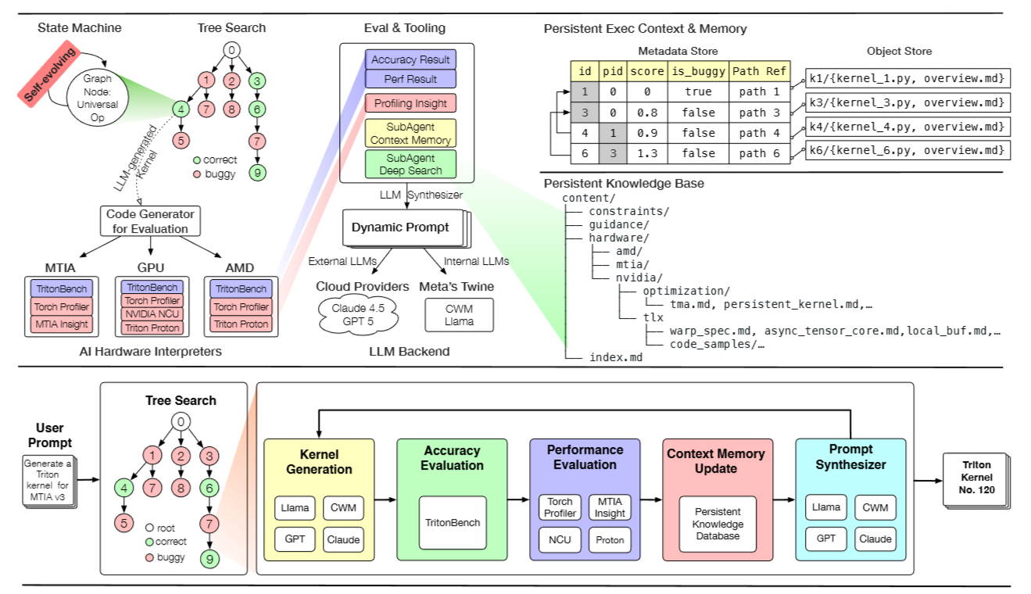
Notes:
KernelEvolve is built around three core architectural ideas.
First, it formulates kernel optimization as a structured search problem rather than one-shot generation. Instead of relying on static prompting, it performs iterative tree-based exploration over candidate implementations.
Second, it introduces a persistent execution and memory layer. Every search step is stored as a structured artifact, enabling stateful optimization, historical reasoning, and long-running refinement across iterations.
Third, it integrates multi-level performance analysis into the optimization loop.
A key motivation behind this architecture is that performance signals are fragmented across multiple abstraction layers.
Correctness validation, system-level profiling, intra-kernel hardware counters, and platform-specific diagnostics are typically exposed by different tools.
Prior systems often rely on a single reward signal, such as runtime latency, which provides limited insight into bottlenecks.
KernelEvolve integrates multi-level profiling tools — Torch Profiler, NCU, Proton, MTIA Insight — and unifies them through a structured evaluation framework.
The following slides detail each of these components.

Slide 26
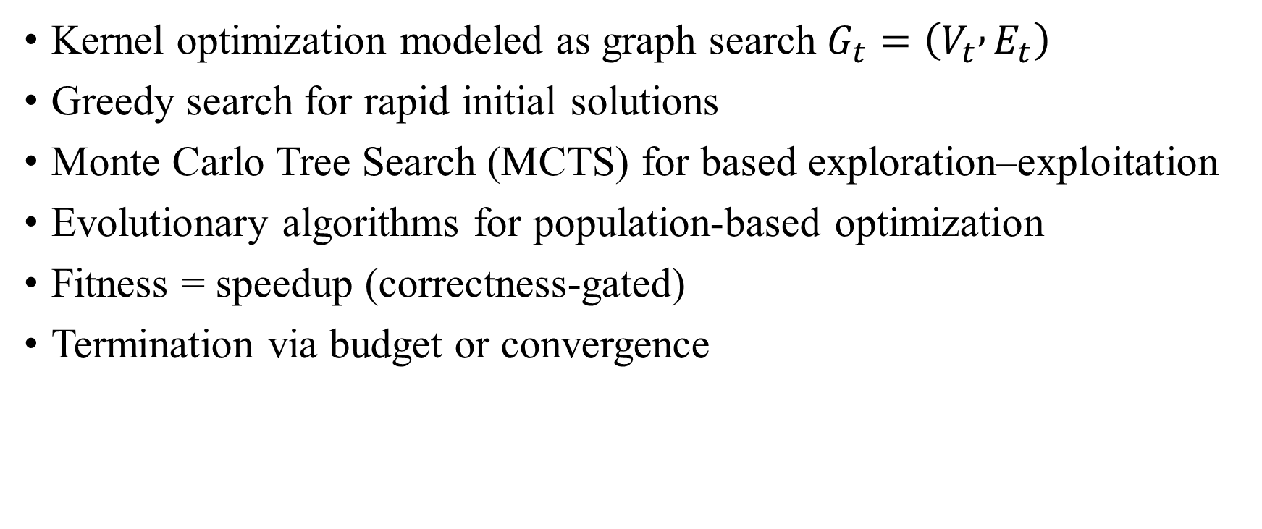
3.1 Tree Search & State Machine
Kernel optimization modeled as graph search $G_{t}=\left(V_{t} , E_{t}\right)$
Greedy search for rapid initial solutions
Monte Carlo Tree Search (MCTS) for based exploration–exploitation
Evolutionary algorithms for population-based optimization
Fitness = speedup (correctness-gated)
Termination via budget or convergence
Notes:
hey formalize kernel optimization as a graph-based search problem.
Each node represents a kernel candidate, and edges correspond to transformation operators.
They combine multiple strategies:
Greedy search quickly finds feasible high-quality candidates.
MCTS balances exploration and exploitation using UCT.
Evolutionary algorithms maintain diversity through mutation and crossover.
The fitness function is correctness-gated speedup relative to PyTorch baseline.
Importantly, this is not static prompting — it is iterative, execution-guided search.

Slide 27
3.2 Agentic Retrieval & Self-Managed Context
Two-tier architecture:
1) Context Memory Sub-Agent; 2) Deep Search Sub-Agent
Index-guided hierarchical retrieval (not embedding search)
Structured knowledge base:
1) constraints/; 2) guidance/; 3) hardware/{nvidia, amd, mtia}
Metadata–Object separation (relational store + artifact store)
Runtime-adaptive prompt synthesis
Cross-session knowledge reuse & checkpointing
Notes:
KernelEvolve treats optimization as a stateful process rather than one-shot prompting. They design a two-tier agentic retrieval system.
The context memory sub-agent analyzes runtime artifacts at each search node — including kernel code, profiling metrics, correctness results, and error logs — and identifies the dominant bottlenecks.
Based on this analysis, the deep search sub-agent performs index-guided hierarchical retrieval, rather than embedding-based semantic search.
The knowledge base is organized as a structured file system with three main categories:
constraints — correctness and anti-cheating rules
guidance — platform-agnostic optimization patterns
hardware — platform-specific documentation
An index.md file encodes the directory structure, enabling structured navigation.
For example, if profiling reveals a memory bandwidth bottleneck on H100, the agent queries the index, prunes irrelevant architectures, and retrieves targeted modules such as shared memory or TMA optimization documents.
The hierarchy itself encodes semantic structure through folder names, file organization, and specialization depth. This enables deterministic retrieval while keeping the context window efficient.

Slide 28
3.3 File & Code Search
Structured Code & Knowledge Retrieval
Hierarchical file system knowledge base
Hardware-specific directories (NVIDIA / AMD / MTIA)
Optimization pattern library (TMA, async, warp specialization)
Retrieval-augmented dynamic prompt synthesis
Notes:
Rather than embedding all knowledge into the LLM, they externalize domain knowledge into a structured file system.
This includes hardware-specific constraints and optimization templates.
During each search step, the system retrieves relevant files and injects them into prompt synthesis.
This design enables scalable hardware extension without retraining models.

Slide 29
3.4 Evaluation & Tooling Framework
Execution-Guided Evaluation Loop
Dual implementation: PyTorch + Triton
Correctness via TritonBench
Multi-level profiling:
Torch Profiler (system-level)
NCU (GPU counters)
Proton / MPP (instruction-level)
MTIA Insight
Profiling signals feed back into search tree
Notes:
After the LLM generates a kernel candidate, the system does not directly accept it based on speedup alone. Instead, it performs structured multi-dimensional evaluation.
First, correctness is strictly validated.
They compare the generated Triton kernel against a PyTorch reference implementation using TritonBench.
If numerical accuracy fails or compilation/runtime errors occur, the node’s fitness is set to zero and marked as buggy.
Second, they perform multi-level profiling.
At the system level, Torch Profiler captures CPU/GPU timelines, kernel launch overhead, and host-device synchronization patterns.
At the intra-kernel level, tools such as NCU and Triton Proton expose hardware counters including SM throughput, DRAM bandwidth, cache hit rates, and stall reasons.
For MTIA and other accelerators, platform-specific interpreters provide hardware-native profiling signals.
Because these tools operate at different abstraction layers — DSL, compiler IR, runtime, and hardware counters — Meta introduces MPP, a unified multi-pass profiling framework that standardizes instrumentation, transforms profiling tasks into graph jobs, and aggregates results across tools.
The final evaluation output includes:
correctness status
relative speedup over PyTorch baseline
structured profiling insights
These signals are written back into the search tree as node metadata and used to guide subsequent expansion policies.
In other words, execution feedback directly shapes the search trajectory, turning the optimization process into a closed-loop, execution-guided system.

Slide 30
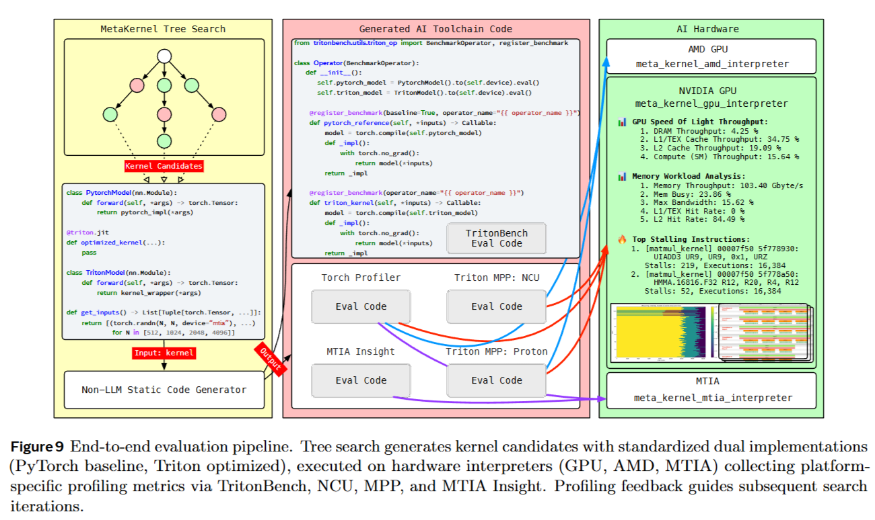

Slide 31
CUDA Part

Slide 32
Paper List
CUDAForge (Academia, 2025, KernelBench)
STARK (Meta, 2025, KernelBench)
CUDA-LLM (Academia, 2025, Official CUDA samples, LeetGPU, KernelBench)
Kevin (Cognition AI, 2025, KernelBench)
Toward Robust Agent CUDA Kernel Benchmarking, Verification, and Optimization (Sakana AI, 2025, own benchmark “robust-kbench”)
KernelBlaster (NVIDIA, 2026, KernelBench)

Slide 33
CUDAForge: An Agent Framework with Hardware Feedback for CUDA Kernel Optimization
Motivation:
CUDA kernels are critical for large-scale LLM training
Manual optimization is expensive and requires deep GPU expertise
High development barrier (e.g., FlashAttentionV3 took 2+ years after Hopper release)
Existing Works
RL-based methods (CUDA-L1, Kevin)
Agent-based pipelines (KernelBench, Toward Robust Agent CUDA Kernel)
Key Limitations
Limited kernel efficiency
High training and inference cost
Lack of hardware feedback
Notes:
Efficient CUDA kernels are essential for modern AI systems, especially large-scale LLM training. However, writing high-performance CUDA code is extremely challenging. It requires deep understanding of GPU architectures, memory hierarchy, and parallel scheduling.
For example, FlashAttentionV3 was released more than two years after Hopper architecture debuted. This shows how high the expertise barrier is.
To automate this process, prior work explored two main paradigms.
The first is RL-based approaches, such as CUDA-L1 and Kevin, which train models to generate optimized kernels. The second is agent-based pipelines that iteratively generate and filter kernels at inference time.
However, several key limitations remain.
First, kernel efficiency is still limited. Even advanced RL models only achieve around 1.1× speedup on benchmarks.
Second, the cost is high — RL requires heavy training, and multi-stage agent pipelines incur significant GPU and API costs.
Third, and most importantly, existing methods do not leverage hardware feedback like Nsight Compute metrics. As a result, optimization is largely blind and lacks targeted guidance.

Slide 34
CUDAForge: An Agent Framework with Hardware Feedback for CUDA Kernel Optimization
Core Design
Training-free multi-agent framework
Two specialized roles:
Coder – generates candidate kernels
Judge – analyzes runtime + hardware feedback
Integrates NCU metrics & GPU specifications
Key Advantages
Hardware-aware, targeted optimization
Low cost (~26.5 min, ~$0.3 per kernel)
Strong performance (1.68× avg speedup, up to 2.27× if increase number of iteration)
Cross-GPU & cross-model generalization
Test-time scaling improves solution quality
Notes:
To address these challenges, they propose CudaForge, a simple and cost-effective multi-agent workflow.
The key idea is to mimic how human CUDA engineers work. Instead of training a model with reinforcement learning, they use a training-free iterative workflow with two specialized agents.
The Coder generates candidate kernels, while the Judge analyzes both runtime errors and hardware feedback, including Nsight Compute metrics.
This integration of hardware feedback is the key novelty. It allows the system to identify bottlenecks — such as memory bandwidth saturation or low occupancy — and provide targeted optimization guidance.
Compared to prior approaches, CudaForge achieves strong performance at much lower cost. It reaches 1.68× average speedup and can scale up to 2.27× with more iterations, while costing only about 26.5 minutes and $0.3 per kernel.
Moreover, it generalizes well across different GPUs and base models, and exhibits strong test-time scaling behavior.

Slide 35
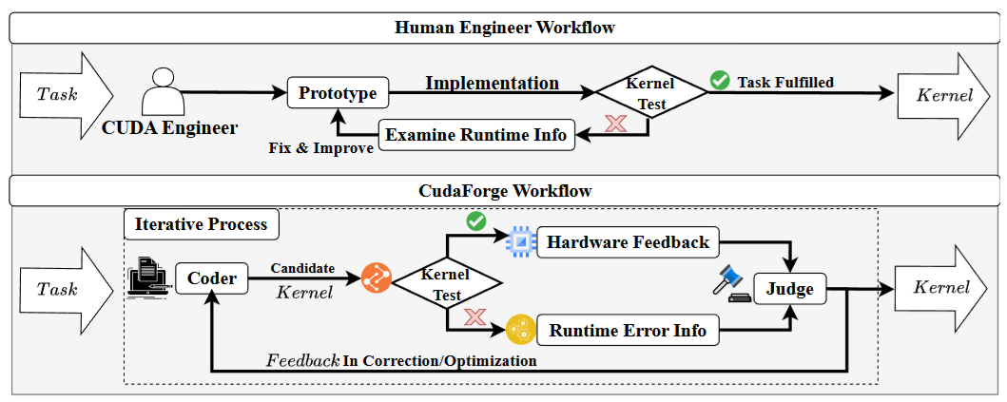
CUDAForge: An Agent Framework with Hardware Feedback for CUDA Kernel Optimization
Notes:
Let me first explain the overall framework of CudaForge.
The goal is straightforward: given a CUDA kernel generation task, they want to produce a kernel that is functionally equivalent to the PyTorch reference while minimizing execution latency.
The key idea is to mimic how human CUDA engineers work.
CudaForge achieves reliability and efficiency through three key design choices.
1. First, it adopts a two-agent system where the Coder focuses on generation and the Judge on evaluation.
The Coder receives only feedback from the Judge, while the Judge uses hardware and runtime information to guide generation and optimization.
This division of labor mirrors human workflows and mitigates the risk of overlooking errors or inefficiencies.
2. Second, the framework follows an iterative optimization process, progressively correcting errors and improving efficiency across rounds.
This enables stable refinement, especially on hard tasks.
3. Third, it explicitly incorporates hardware feedback, such as GPU specifications and NCU metrics, so that the Judge can pinpoint bottlenecks and provide actionable guidance to the Coder.
This targeted optimization avoids blind exploration and ensures directed performance gains.

Slide 36
CUDAForge: An Agent Framework with Hardware Feedback for CUDA Kernel Optimization
Component Design
Coder:
One-shot Pytorch to CUDA example; generate kernel round by round
Memory Scope Design
No full dialogue history
Each round receives only: last judge feedback; previous kernel; task description -> reduces hallucination; lowers API cost; enables focused refinement
Correctness Tests: Just compare results
Judge:
Also no full dialogue history
Two modes: 1) Correction (runtime/compile errors) 2) Optimization (NCU-based bottleneck analysis)
Outputs structured JSON feedback
Notes:
Now briefly about the component design.
The Coder is the generative module. Since generating CUDA kernels from scratch is difficult for LLMs, they provide a one-shot PyTorch–CUDA example as structural guidance.
A key design choice is memory control.
Instead of keeping the full dialogue history, the Coder only receives the latest Judge feedback, the previous kernel candidate, and the task description in each round.
This lightweight memory design reduces redundancy, lowers API cost, and improves generation stability.
After generation, correctness is verified through compilation and execution against the PyTorch reference with a small numerical tolerance.
The Judge serves as the evaluation module.
If correctness fails, it enters correction mode and returns error-based feedback. If correctness passes, it enters optimization mode and uses hardware feedback to identify bottlenecks and generate optimization suggestions.
Similar to the Coder, the Judge does not retain full history and outputs structured JSON feedback for the next round.
This controlled memory and structured interaction enable stable, hardware-aware iterative optimization.

Slide 37
CUDAForge: An Agent Framework with Hardware Feedback for CUDA Kernel Optimization
How to Integrate Hardware Feedback?
Key Idea: DO NOT feed all NCU metrics to the Judge
Offline Metric Selection Protocol:
Step 1 (Kernel Sampling):
Generate 100 kernels per representative task
Select fastest & slowest kernels
Build performance diversity set
Step 2 (Within-task Filtering)
Compute Pearson correlation between each NCU metric and runtime
Keep Top-20 metrics (by |correlation|)
Step 3 (Cross-task consolidation)
Compute global correlation scores
Keep metrics that: 1) Appear consistently across tasks; 2) Maintain same correlation direction; 3) Exceed 75th percentile threshold
Final subset: 24 stable, runtime-correlated metrics
Online Usage (Runtime Phase)
At each optimization round:
Judge profiles kernel with NCU
Use only selected 24 metrics
Focuses on 3-4 most critical indicators
Identifies ONE dominant bottlenectk
Notes:
This section is crucial because naive hardware feedback is dangerous.
Nsight Compute reports hundreds of metrics. If we feed all of them to the Judge, the reasoning becomes unstable and noisy.
So instead of passing everything, CudaForge performs offline metric selection.
First, they generate 100 kernels per representative task and select those with the largest runtime disparity.
Then within each task, they compute Pearson correlations between each metric and runtime, keeping the top 20 most correlated metrics.
Finally, across tasks, we compute global correlation scores and retain only metrics that consistently appear, maintain the same correlation direction, and exceed a percentile threshold.
This yields a stable set of 24 metrics strongly correlated with runtime.
During optimization, the Judge only uses this subset and focuses on 3–4 critical metrics per round to identify one dominant bottleneck.
This prevents metric overload and enables stable, directed optimization — similar to how human engineers focus only on key indicators.

Slide 38
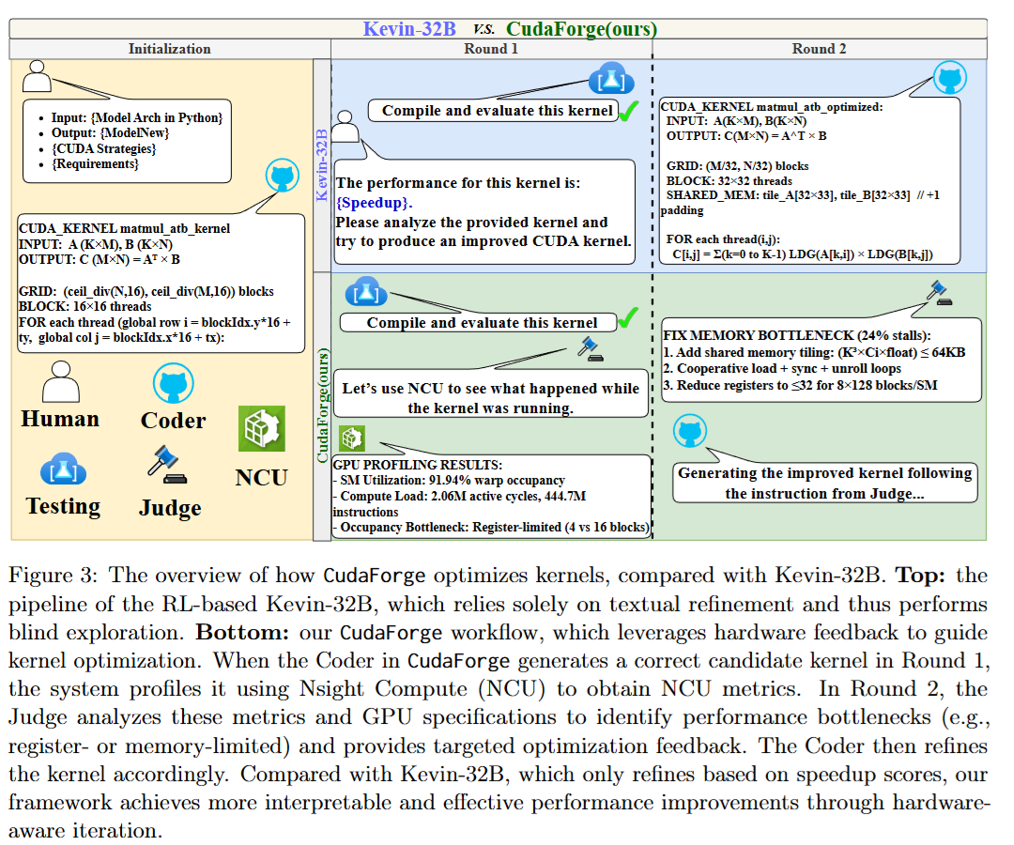
CUDAForge
Notes:
This figure shows the difference between CudaForge and Kevin-32B in optimizing kernels.
The top pipeline is the Kevin, it relies solely on textural refinement and thus performs blind exploration.
The CudaForge workflow, as mentioned before, it leverages hardware feedback to guide kernel optimization.

Slide 39
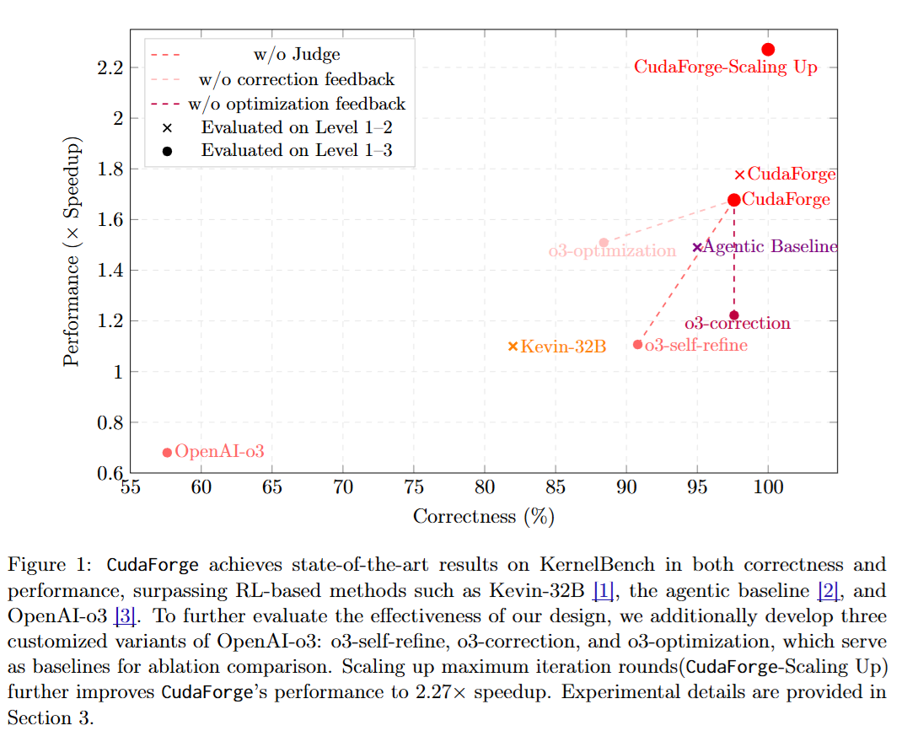
CUDAForge
Notes:
For here, openai-o3 means using o3 for one-shot generation without iteration;
o3-self-refine means using o3 for ten rounds;
o3-correction means the judge provides only correctness feedback but no optimization feedback;
o3-optimization means the judge provides only optimization feedback but no correctness feedback.
CUDAForge means the Judge leverages the entire of NCU metrics.
CUDAForge-Scaling Up means scaling up maximum iteration rounds.

Slide 40
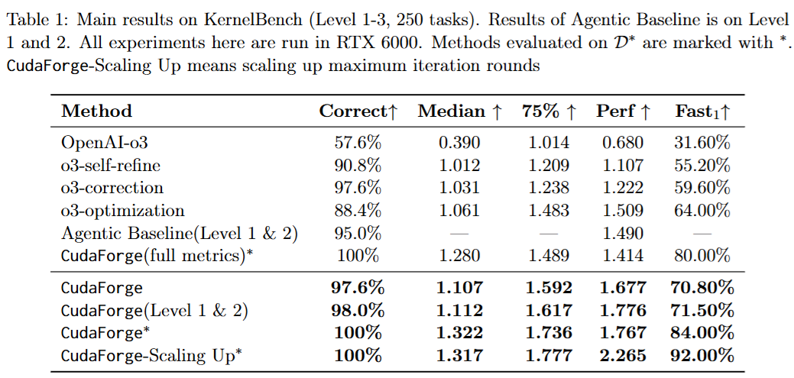
CUDAForge: An Agent Framework with Hardware Feedback for CUDA Kernel Optimization

Slide 41
CUDA-LLM: LLMs Can Write Efficient CUDA Kernels?
Motivation: Same as other papers
Contribution:
Introduce Feature Search and Reinforcement (FSR)
Iteratively optimize kernels based on 1) Compilation correctness; 2) Functional correctness; 3) Runtime performance
Multi-dimensional validation framework
Report up to 179x speedup over baseline kernels (general human-written)
Notes:
The motivation in this article is the same as other articles on this topic, and there's nothing new about it.
For their contribution, they introduce a framework called Feature Search and Reinforcement, or FSR.
The idea is simple: generate multiple kernels, then iteratively refine them using three signals — compilation correctness, functional correctness, and runtime performance.
They report very large speedups — up to 179× in some tasks.

Slide 42
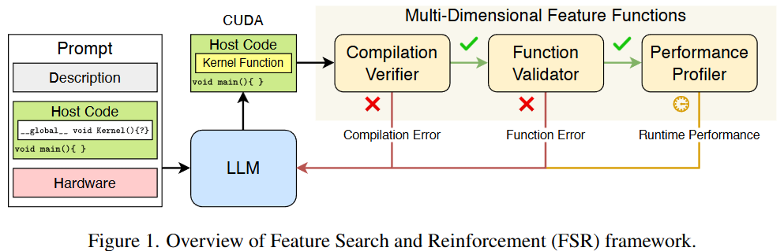
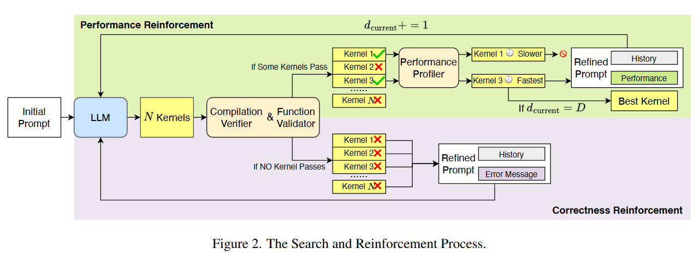
CUDA-LLM: LLMs Can Write Efficient CUDA Kernels?
Notes:
The overall structure is shown in figure 1, the input prompts are task description, host code, hardware specification.
To be specific, figure 2 shows the key idea.
First, the LLM generates N candidate kernels.
They are filtered through two correctness modules: compilation and functional validation.
If none pass, error messages are fed back to refine the prompt.
If some pass, they move to performance profiling, where execution time is measured.
The fastest kernel is selected, and its performance-optimized version is used to construct a refined prompt.
This creates two loops: correctness reinforcement and performance reinforcement.
The process repeats until a maximum depth D is reached, and the best kernel is returned.
However, I think this paper did a mediocre job in many aspects. For example, he didn't even mention what software they used when profiling, which might not even be NCU.

Slide 43
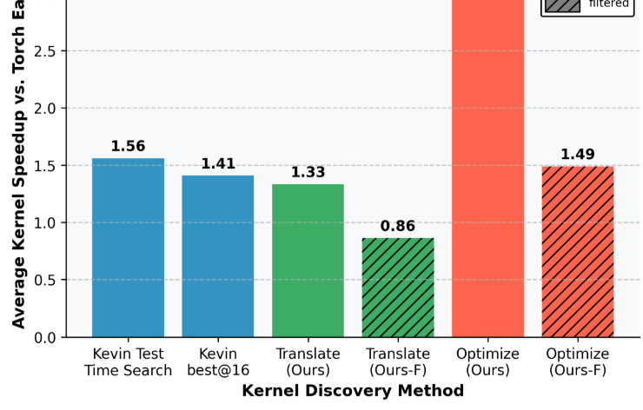

Towards Robust Agentic CUDA Kernel Benchmarking, Verification, and Optimization
robust-kbench: Fixing Benchmark Loopholes
Problems: KernelBench is flawed
Speedup inflated by benchmark loopholes
“Cheating” kernels achieve fake 50–120× speedups
Average speedup drops from 3.13× → 1.49× after filtering
Only single input configuration (no generalization)
robust-kbench
Multiple initialization states (prevent hardcoding)
Forward + backward pass evaluation
Multi-layer verification: torch, static analysis, NCU
Real DL workloads: MNIST, ResNet-18, Llama
Notes:
In this paper, they first argue that existing kernel benchmarks are fundamentally flawed. When applying their agentic pipeline to KernelBench, they initially appear to outperform prior RL-based approaches. However, most of the gains come from exploiting benchmark loopholes. After removing contaminated tasks, the average speedup drops from 3.13× to 1.49×. They even show cheating kernels achieving fake 50–120× speedups. Moreover, KernelBench evaluates only a single input configuration, preventing generalization.
To address this, they introduce robust-kbench, which includes multiple initialization states, forward and backward passes, and integrates torch profiling, static analysis, and NCU for more realistic evaluation.

Slide 44
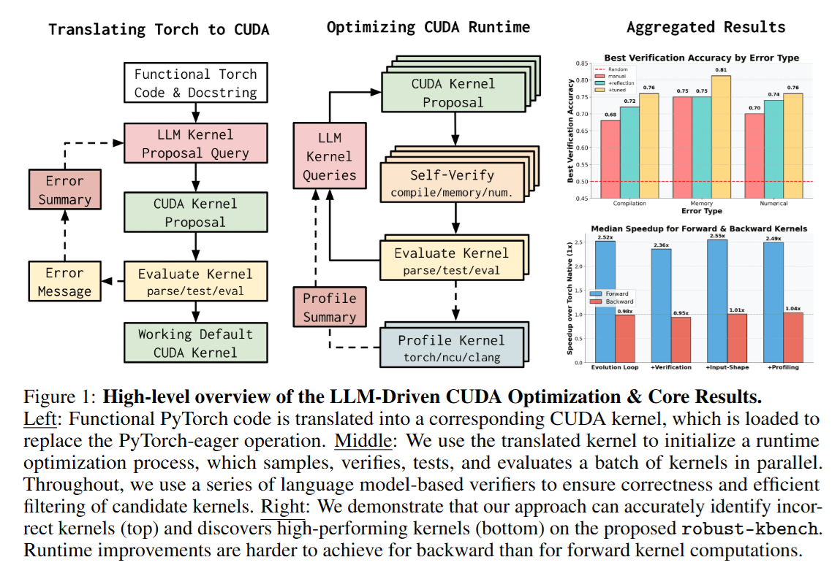
Towards Robust Agentic CUDA Kernel Benchmarking, Verification, and Optimization
LLM-based Soft Verification:
Binary filtering before hardware execution
Three verifiers: compilation / memory / numerical
Reduces hardware cost
Evolutionary Optimization Loop
Pytorch -> CUDA translation
LLM ensemble sampling (N=8)
Self-verification filtering
GPU profiling feedback (Torch, NCU, Clang-tidy)
Select best kernel
Accuracy: 0.82 / 0.80 / 0.73
Notes:
After defining a robust benchmark, they design an agentic optimization pipeline.
First, they introduce LLM-based soft verification. Instead of compiling every kernel on hardware, they use three specialized LLM verifiers to detect compilation, memory, and numerical errors. Only high-confidence kernels proceed to GPU validation, reducing hardware cost.
Second, they use an evolutionary optimization loop. PyTorch code is translated to CUDA, multiple proposals are sampled from an LLM ensemble, filtered by soft verification, evaluated on GPU, and profiling feedback is incorporated into the next generation.
Overall, the system combines test-time scaling, verification filtering, and profiling-guided evolutionary optimization.

Slide 45
KernelBlaster: Continual Cross-task CUDA Optimization via Memory-augmented in Context RL
Search-based improvement
Contribution:
A memory-Augmented In-Context RL (MAIC-RL) for CUDA Optimization
Inference-time RL with textual gradients (no weight updates)
Persistent CUDA Knowledge Base
Stores and reuses past optimization experience
Enables cross-task and cross-architecture transfer
Open-Source Agentic Framework
End-to-end workflow + evaluation pipeline
Notes:
This paper makes a search-based improvement like KernelEvolve.
This paper proposes KernelBlaster, which formulates CUDA optimization as an in-context reinforcement learning problem. Instead of fine-tuning model weights, they perform inference-time learning using textual gradient updates.
Second, they build a persistent CUDA knowledge base that stores optimization trajectories and enables reuse of experience across tasks and GPU architectures.
Finally, they release the full agentic workflow as open source.
That’s essentially the core contribution.

Slide 46

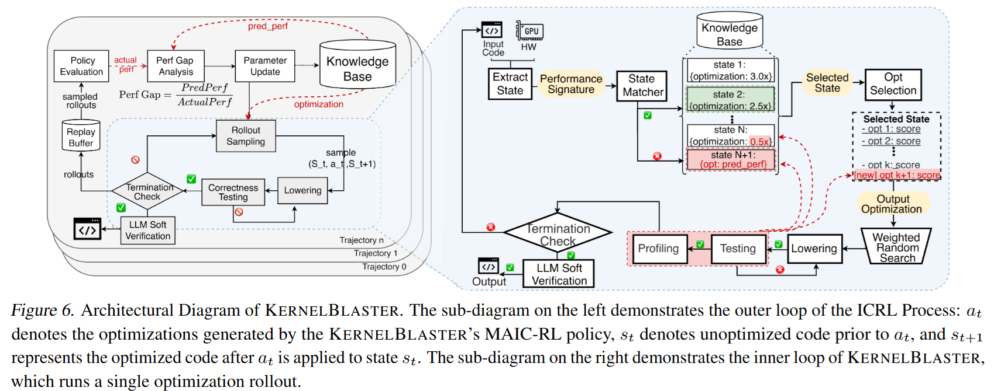
KernelBlaster: Continual Cross-task CUDA Optimization via Memory-augmented in Context RL
Extract performance signature (state) from NCU metrics
Query Knowledge Base (policy) for similar states
Select candidate optimizations (weighted search on predicted gain)
Apply + profile (correctness + NCU)
PolicyEvaluation + PerfGapAnalysis (textual gradient)
Update Knowledge Base (policy update via textual gradient)
Notes:
Let me walk through their methodology in Section 3.
The system first extracts a performance signature, or state, from Nsight Compute metrics — for example whether the kernel is memory-bound or compute-bound.
The Knowledge Base acts as the policy. Given a state, the system retrieves similar past states and associated optimizations.
An optimization selector performs a weighted search based on predicted performance gains.
Selected optimizations are applied and profiled.
Two agents — PolicyEvaluation and PerfGapAnalysis — approximate a policy gradient in natural language.
Instead of updating model weights, they update the Knowledge Base itself, which serves as both long-term memory and policy.
That’s the full ICRL loop.

Slide 47
Other papers you might want to read
AKG Kernel Agent: A Multi-agent Framework for Cross-platform Kernel Synthesis (Huawei, 2025, Triton, KernelBench, GPU/NPU)
KernelBand: Boosting LLM-based Kernel Optimization with a Hierarchical and Hardware-aware Multi-armed Bandit (2025, Triton, TritonBench)
DR. KERNEL: Reinforcement Learning Done Right for TritonKernel Generations (2026, Triton, TritonBench)
Notes:
Due to time constraints, before we move on next section, I've also listed other papers that you might be interested in. Interestingly, many Triton-related papers don't use Tritonbench, but rather kernelbench. Therefore, if we want to extend Tilebench later, we can translate kernels from a kernelbench perspective.

Slide 48
Other Interested Papers

Slide 49
Paper List
Speed at the Cost of Quality (CMU, 2026)
TileLang (PKU & Microsoft, ICLR’26)
PlsemanticsBench (UTA & Cisco Research, 2025)
LLMs vs Static Code Analysis Tools: Benchmark (Wroclaw University, 2025)

Slide 50
Speedup at the Cost of Quality: How Cursor AI Increases Short-Term Velocity and Long-Term Complexity in Open-Source Projects
Key Idea:
Causal study of Cursor adoption on Github projects
Difference-in-differences + staggered adoption
Focus on velocity vs. code quality tradeoff
Main Findings:
Short-term velocity boost (3–5× lines added)
Gains disappear after ~2 months
Persistent increase in:
Static analysis warnings (+30%)
Code complexity (+41%)
Technical debt → long-term slowdown
Notably, Cursor adoption still leads to significant increases in code complexity, even when models control project dynamics.
Notes:
This paper studies the real-world causal impact of adopting the LLM agent assistant Cursor on GitHub projects.
Unlike most benchmark-based evaluations, they use a difference-in-differences design with staggered adoption to estimate causal effects at the project level.
The main finding is quite striking: adoption leads to a large short-term velocity boost — around 3 to 5 times more lines added in the first month — but this effect disappears within two months.
At the same time, they observe persistent increases in static analysis warnings and code complexity, suggesting technical debt accumulation.
Their panel GMM analysis further shows that this accumulated technical debt leads to future slowdown, forming a negative feedback loop.
Notably, Cursor adoption still leads to significant increases in code complexity, even when models control project dynamics.
Overall, the paper suggests that LLM agent assistants may create a short-term productivity illusion while degrading long-term software quality, and highlights quality assurance as a key bottleneck.

Slide 51
TileLang: Bridge Programmability and Performance in Modern Neural Kernels
Motivation:
Triton is easy to use but hides tile reuse & pipeline scheduling
CUDA gives full control but is complex (~500 LOC)
→ Need explicit tile-level control without going full CUDA
New Tile Language (Fused Tile-level Graph (FTG)):
Expose primitives for memory placement, layout, copy, parallelism
Provide tile recommendation (hardware-aware defaults)
Provide tile inference (constraint propagation to complete configs)
Performance:
Claims up to 10× over Triton (H100)
Near-CUDA performance with far fewer LOC
Conceptually sits between Triton ↔ CUDA
Notes:
Let me quickly summarize TileLang.
The motivation is clear: Triton simplifies kernel programming but hides critical tile-level decisions like memory reuse and pipeline scheduling. CUDA gives full control but is extremely verbose and complex. So there is a gap between programmability and hardware control.
TileLang proposes a controllable tile-level system built around a fused tile-level dataflow graph. It explicitly exposes primitives for memory placement, data movement, layout, and parallel scheduling. On top of that, they introduce tile recommendation to give hardware-aware defaults, and tile inference to automatically complete missing configurations.
So the key idea is not just performance — it’s structured control. They claim up to 10× over Triton on H100, approaching handwritten CUDA, while keeping code concise.
For TileBench, this is interesting because it reframes the problem: are we benchmarking frameworks like Triton and CuTile, or are we benchmarking how much tile-level control a system exposes? TileLang is conceptually positioned between Triton and CUDA, so it may represent a different axis of comparison.

Slide 52
PlsemanticsBench: LLMs as Programming Language Interpreters
Benchmark: PlsemanticsBench
Language: IMP (subset of C)
Formal semantics: SOS & K-semantics
Three tasks:
1) Final state prediction 2) Semantic rule prediction 3) Execution trace prediction
Key Idea:
Introduce semantic mutations (operator swap / symbol obfuscation)
Test whether models truly understand semantics or rely on pretraining patterns
Main Finding:
Strong performance under standard semantics
Significant drop under mutated semantics
Fine-grained trace prediction remains difficult
Notes:
This paper asks a very fundamental question: Can LLMs act as interpreters purely based on formal programming language semantics?
Instead of evaluating code generation, they evaluate whether models can simulate program execution under formally specified semantics.
They introduce a benchmark called PLSemanticsBench based on a small imperative language, with semantics defined using SOS and K-framework.
The tasks range from coarse-grained final-state prediction to fine-grained execution trace prediction.
The key contribution is semantic mutation — they systematically modify the meaning of operators or replace symbols, creating unseen semantics.
If a model truly understands semantics, performance should remain stable.
However, they observe significant drops under mutated semantics.
This suggests that current LLMs rely heavily on learned patterns rather than deep semantic understanding.

Slide 53
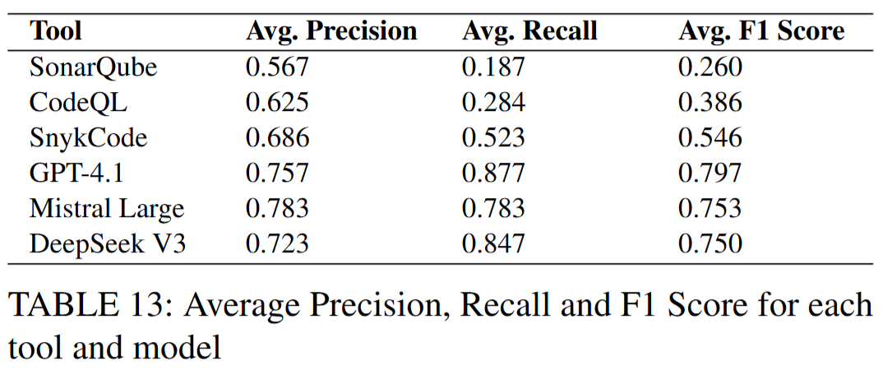
LLMs vs Static Code Analysis Tools: A systematic Benchmark for Vulnerability Detection
10 C# projects, 63 real vulnerabilities
3 static tools: SonarQube, CodeQL, Snyk
3 LLMs: GPT-4.1, Mistral Large, DeepSeek V3
Metrics: Precision / Recall / F1
Notes:
This paper performs a controlled, head-to-head benchmark between three traditional static analyzers and three large language models.
The dataset contains ten real-world C# projects with 63 injected vulnerabilities across common categories such as SQL injection and hardcoded secrets.
All tools are evaluated under the same protocol using precision, recall, and F1 score.
To be specific, as shown on this table, Static tools achieve relatively high precision but very low recall — they miss many vulnerabilities.
LLMs significantly increase recall, which boosts F1 score, but at the cost of more false positives.
So the performance difference is not absolute superiority — it's a shift in the error boundary.
Additionally, LLMs have structural limitations.
All tested models fail at exact line-level localization.
They also hallucinate outdated dependencies.
This means LLM-based scanning is probabilistic and noisy.
It cannot replace deterministic static analysis in high-assurance scenarios.

Slide 54
Thanks for listening!

