Slide 2
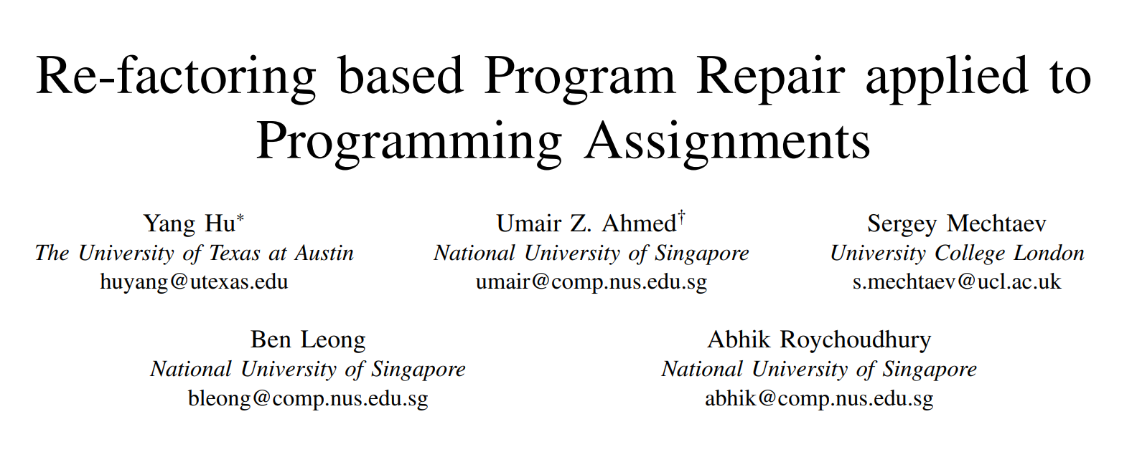
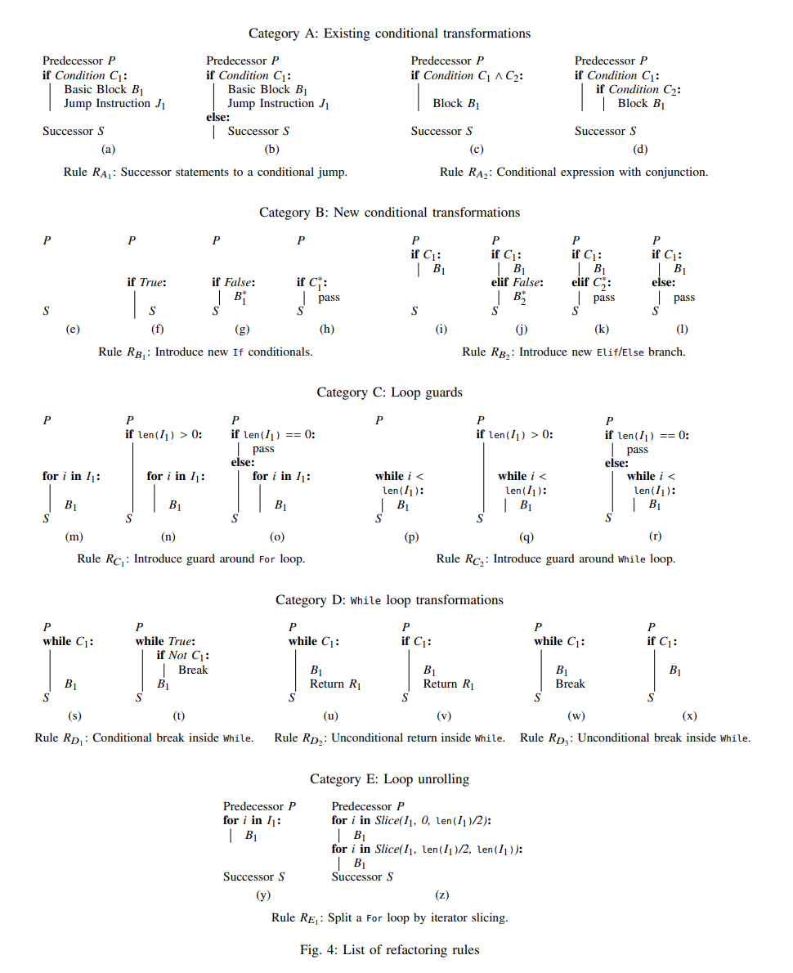
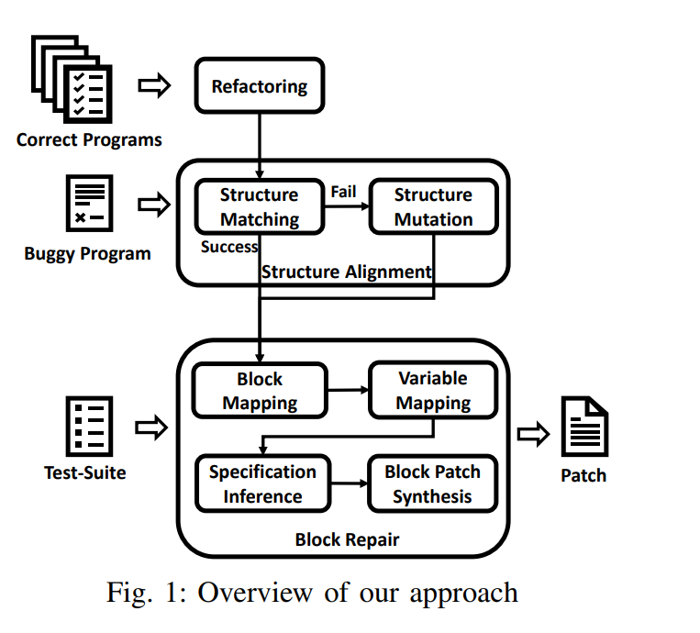
Debugging Before LLM : Buggy Code -> patch generation -> AST mapping ->test ->merge->final code

Slide 3
Debugging Before LLM : Buggy Code -> patch generation -> AST mapping ->test ->merge->final code
Hard Coding part
Weakness:
Inefficient
Low success rate
Bad Scalability

Slide 4
Now we can replace it with LLM
Debugging Before LLM : Buggy Code -> patch generation -> AST mapping ->test ->merge->final code
Hard Coding part
Weakness:
Inefficient
Low success rate
Bad Scalability

Slide 5
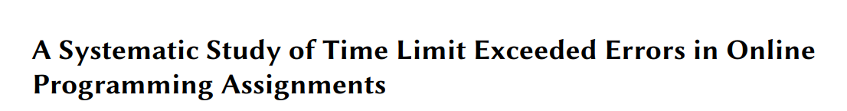
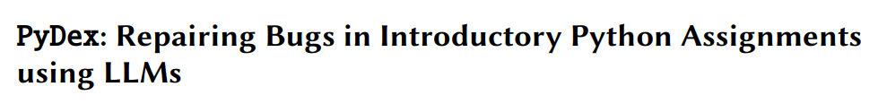
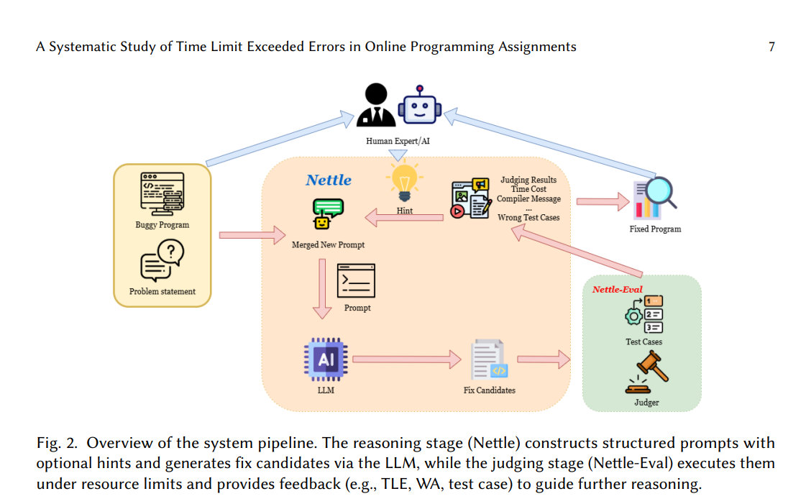
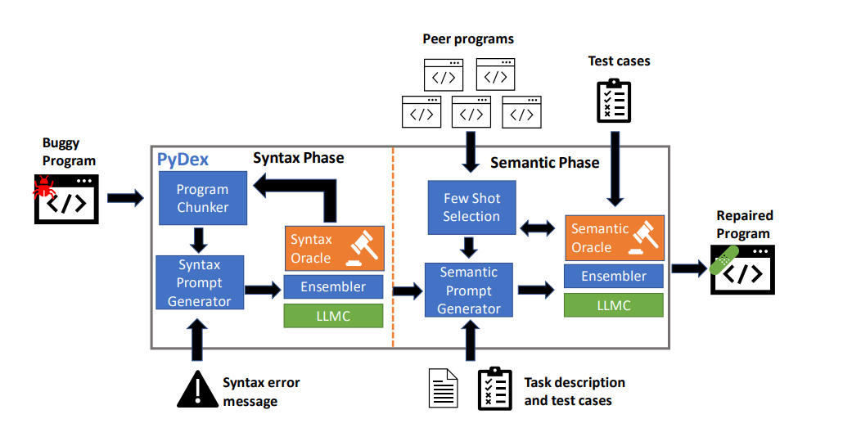
Debugging after LLM : Buggy Code -> LLM -> test->fixed code

Slide 6
Debugging after LLM : Buggy Code -> LLM -> test->fixed code
New Problem:How can we make the LLM output more reliable?

Slide 7
Debugging after LLM : Buggy Code -> LLM-> test->fixed code

