Slide 1
GPU Architecture,
Learning to Simulate &
Reinforcement Learning
Junyu Yin

Slide 2
  GPU Background
  Related Work
  My Research: Learning to Simulate
  RL for Arch Research
Contents

Slide 3
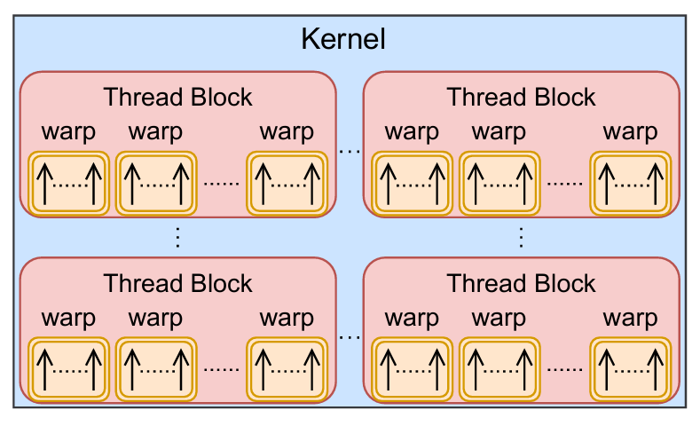
GPU Execution Model
  A GPU program or a kernel
    A task launched from the host (CPU) side
    Organized as a grid of thread blocks runs in parallel
  Thread Block (CTA)
    A minimal scheduling unit onto Streaming Multiprocessors (SMs)
    Threads within the same block can synchronize execution and cooperate via shared memory
  Warp
    A group of typically 32 threads within a block
    All threads in a warp execute the same instruction in lockstep (SIMT)
    Warp divergence: threads within the same warp take different execution paths
3

Slide 4
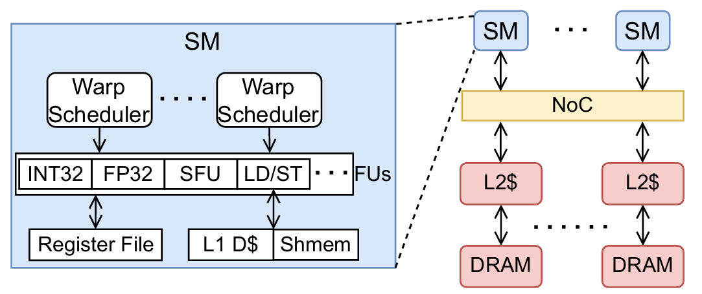
GPU Hardware Model
  Streaming Multiprocessors (SMs)
    Each GPU contains multiple SMs
    An SM executes warps using SIMT model
    An SM has many resources: warp schedulers, functional units, register files, L1 memory, ….
  Warp Scheduler
    Dynamically schedules ready warps to different functional units
    There are typically 4 warp schedulers within an SM, and they support multiple scheduling strategies: GTO, LLR, …
  L1 Memory
    Per-SM private, split into: L1 data cache and shared memory
  L2 Cache & Global Memory (DRAM)
    L2 Cache: shared across all SMs within a NoC
    DRAM: High-capacity, high-latency memory accessible by all threads
It’s a simplified introduction!
4

Slide 5
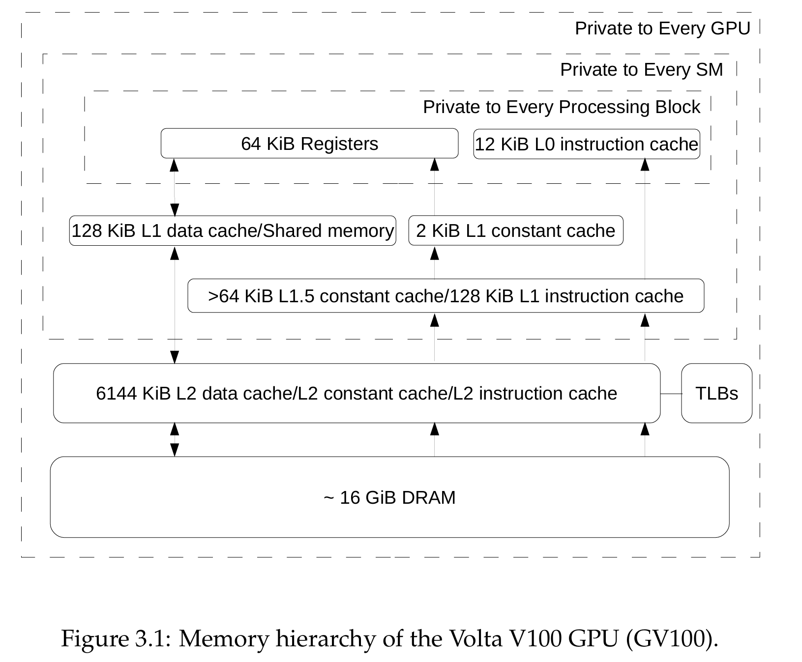

Slide 6
GPU Performance Modeling Challenges
  High degree of parallelism
    Each SM has thousands of threads, and a GPU can have hundreds of SMs
    Synchronization and resource contention across so many threads create complex and unpredictable interactions
  Memory behaviors are irregular
    In GPUs, a single memory instruction can generate anywhere from 1 up to 32 memory transactions (coalesced vs. scattered, aligned vs. unaligned)
    Combined with multi-level memory hierarchy, the overall memory behavior becomes complex and hard to predict
  Hardware details are not fully documented
    They are kept as top secrets by major companies
6

Slide 7
  GPU Background
  Related Work
  My Research: Learning to Simulate
  RL for Arch Research
Contents

Slide 8
Table of GPU Modeling methods
Modeling Methods |  | Running Time | Accuracy | Complexity of Implementation
Cycle-level Simulator | Execution-driven | Long | High | High
 | Trace-driven | Medium | Medium | High
Analytical Modeling |  | Fast | Low to Medium | Medium to High
Ideal GPU Simulator |  | Fast | High | Medium
8

Slide 9
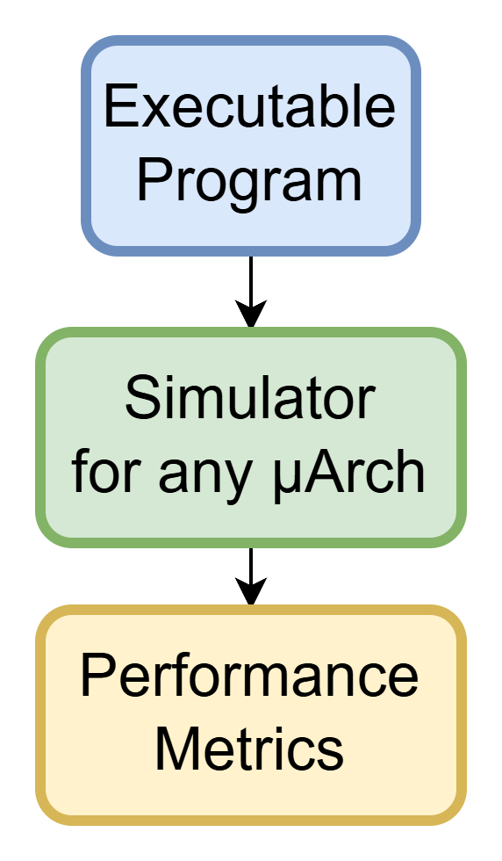
Modeling Approach1: Execution-driven Simulation
  What is it?
    A technique where the actual instructions of a program are executed in a simulated environment
  Characteristics
    Dynamic: it models the effects of each instruction by executing them
    Accurate: it captures detailed impact of every instruction on the system
    Time-consuming: it can take days to years for simulating large programs
  Examples: GPGPU-Sim [1], MGPUSim [2]
[1] Bakhoda, Ali, et al. "Analyzing CUDA workloads using a detailed GPU simulator." 2009 IEEE international symposium on performance analysis of systems and software.
[2] Sun, Yifan, et al. "MGPUSim: Enabling multi-GPU performance modeling and optimization." 2019 ACM/IEEE 46th ISCA.
9

Slide 10
Gpgpu-sim
  Overview
    Open-source, widely used academic GPU simulator
    Models NVIDIA-like GPUs at a detailed, cycle-accurate level
    Support PTX execution emulation
      PTX: a low-level parallel-thread execution virtual machine and ISA
  Strengths
    High fidelity: captures almost micro-architectural behaviors
    Open source: can monitor the whole lifetime of an instruction
  Limitations
    Extremely slow: simulating a single kernel can take hours or days
    It is also an approximation of NVIDIA GPUs
10

Slide 11
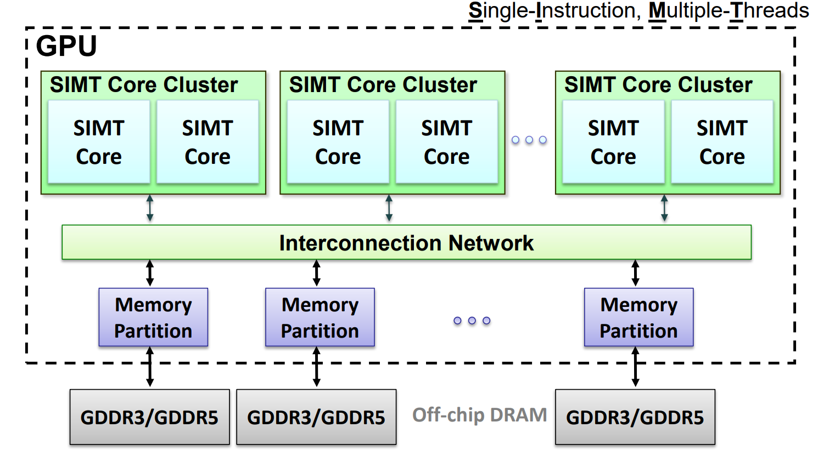

Slide 12
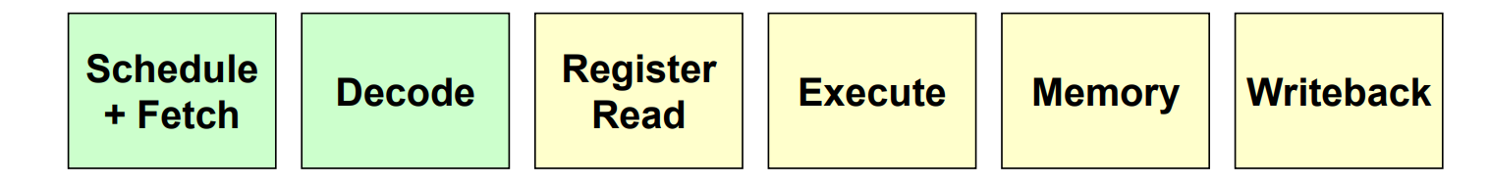
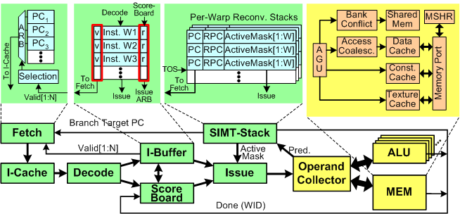
This is a project with ~100k lines of cpp code, so I won’t go into the details here.

Slide 13
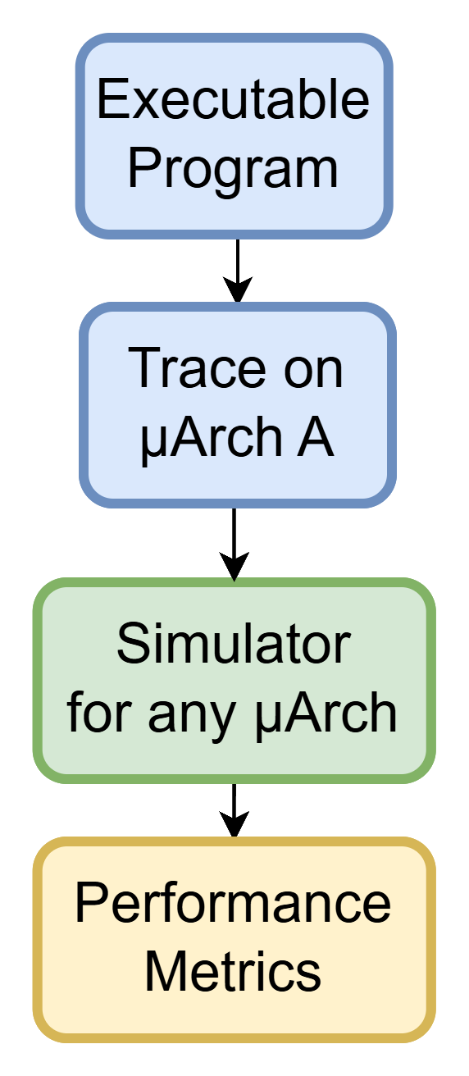
Modeling Approach2: Trace-driven Simulation
  What is it?
    A technique where a pre-recorded trace from a program’s execution is used as the input for the simulation
    A trace can be obtained from another simulator or by instrumenting a program
    Trace: a log of executed instructions with additional running information like memory address
  Characteristics
    Static: the trace is captured once and is fixed during the simulation
    Replay-based: it only replays the trace without executing the actual program
    Time-efficient: it avoids re-executing each instruction during simulation
    Accuracy-limited: it reuses the same trace for different microarchitectures
  Examples: Accel-Sim [1]
13
[1] Khairy, Mahmoud, et al. "Accel-Sim: An extensible simulation framework for validated GPU modeling." 2020 ACM/IEEE 47th ISCA.

Slide 14
Accel-sim
  Overview
    Built on top of GPGPU-Sim to provide SASS trace-driven simulation modes
      SASS: native assembly language of NVIDIA GPUs
  Strengths
    Integrated with CUDA profiling tools NVBit
    Maintains cycle-accuracy while improving efficiency
  Limitations
    Still much slower than real hardware
    Remains an approximation of NVIDIA GPUs
14

Slide 15
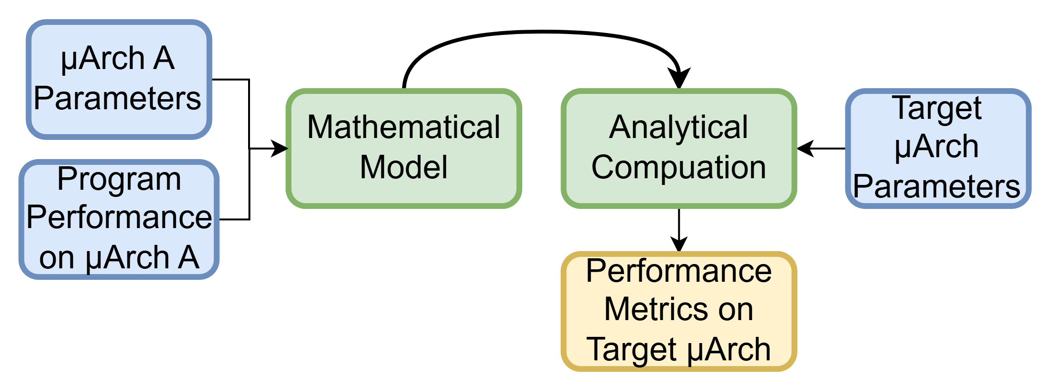
Modeling Approach3: Analytical Modeling
  What is it?
    A technique that uses mathematical formulas to estimate system performance based on certain assumptions
  Characteristics
    Abstract: it uses simplified assumptions to model systems
    Fast: it is much faster than simulations
    Accuracy-limited: heuristic assumptions can be wrong and detailed behaviors are ignored
  Examples: GPUMech [1], GCoM [2]
[1] Huang, Jen-Cheng, et al. "GPUMech: GPU performance modeling technique based on interval analysis." 2014 47th Annual IEEE/ACM International Symposium on Microarchitecture.
[2] Lee, Jounghoo, et al. "GCoM: a detailed GPU core model for accurate analytical modeling of modern GPUs." 2022 ACM/IEEE 49th ISCA.
15

Slide 16
GPUMech
  Overview
    Interval-Analysis Based GPU Performance Modeling
    Identifies stall events (memory divergence, control divergence, resource contention) from warp traces
  Strengths
    Provides CPI stack breakdowns for bottleneck analysis
    ~97× faster than cycle-accurate simulators
  Limitations
    Accuracy gap v.s. hardware/simulator
    Less flexible for modeling new GPU architectural features
16

Slide 17
2014 MICRO

Slide 18
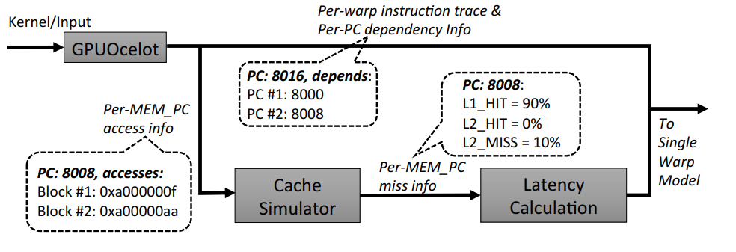
Methodology
Model Workflow
  Collect Input
    Generate per-warp instruction traces with a functional simulator
    A cache simulator reads the memory instructions from the trace of each warp in a round-robin fashion to get the per-memory PC miss rates
      Miss rates are calculated across all warps
    Get the latency of per PC
      Compute PCs: fixed and based on the system configurations
      Memory PCs: average memory access time
        A memory PC hits L2 (120 cycles) for 90% of the executions and misses L2 (420 cycles) for the rest has the latency 150 = 0.9 × 120 + 0.1 × 420 cycles
        For a divergent memory instruction, its miss event depends on the memory request with the longest latency
18

Slide 19
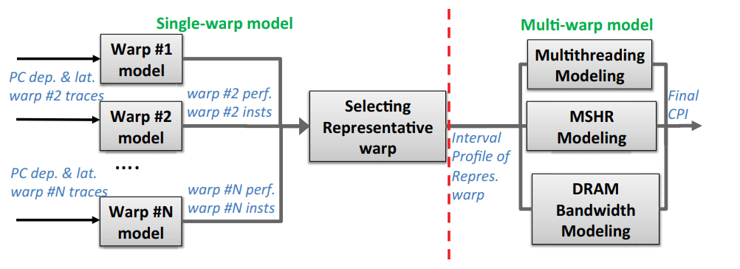
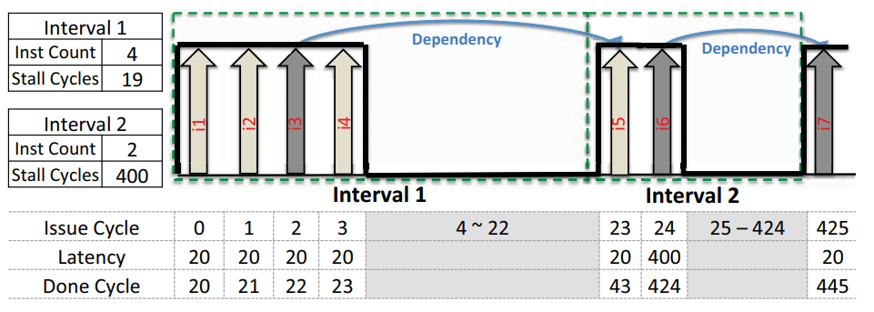
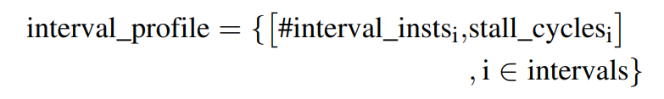
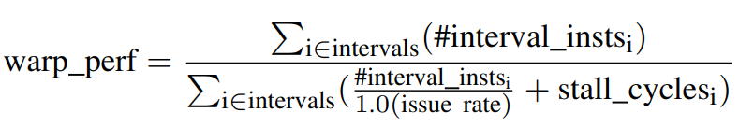
Methodology
Model Workflow
  Single-warp model & selecting
    Profile each warp with the interval algorithm
    Selecting representative warp
      Use the k-means algorithm, setting the number of clusters to two
      Define per-warp warp performance (IPC)
      Define per-warp feature vector
Issue rate: 1 inst / cycle
19

Slide 20
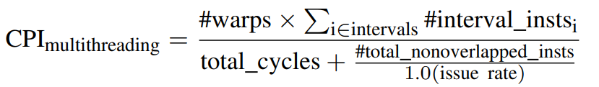
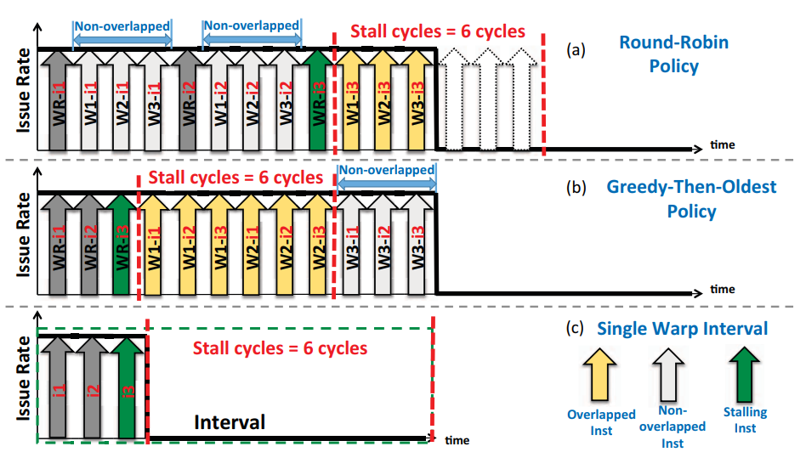
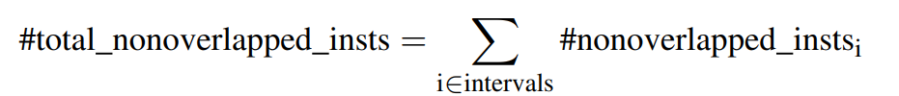
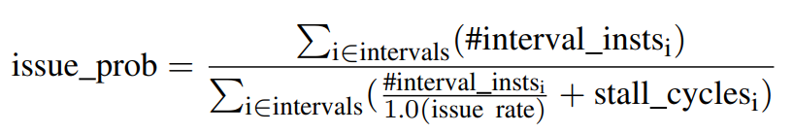
Methodology
Model Workflow
  Multi-warp model: 1) Modeling Multithreading
    Some instructions do not hide the stall cycles, leading to sub-optimal performance
      Call them non-overlapped instructions
    Use the interval profile of the representative warp and predict the performance under 2 scheduling policies
    issue probability = the probability that
    a warp can issue an instruction in a cycle
    cycle
20

Slide 21
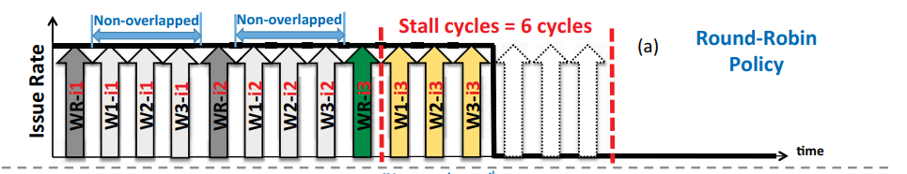
Methodology
Model Workflow
  Multi-warp model: 1) Modeling Multithreading
    Round-Robin Policy
      Assume the non-overlapped instructions are issued within several “waiting slots”
      Assume within a waiting slot, every remaining warp is scheduled
21

Slide 22
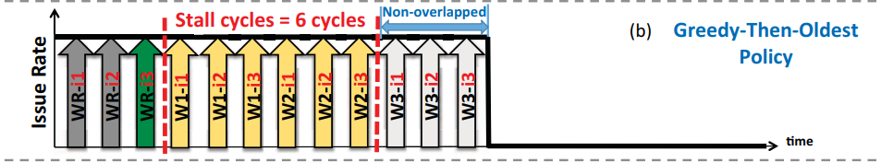
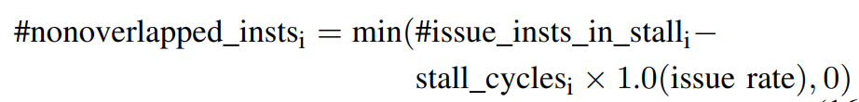
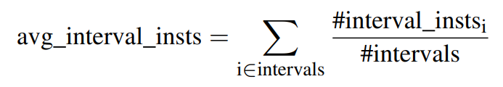
Methodology
Model Workflow
  Multi-warp model: 1) Modeling Multithreading
    Greedy-Then-Oldest Policy
      Assume the non-overlapped instructions are incurred if the number of issued instructions is more than the stall cycles
      avg_interval_insts = the number of issued instructions for a remaining warp
      #issue warps in stall = the number of warps that issues instructions during the stall cycles
        Assume the “oldest” policy equalizes the probability of each warp being scheduled
22

Slide 23
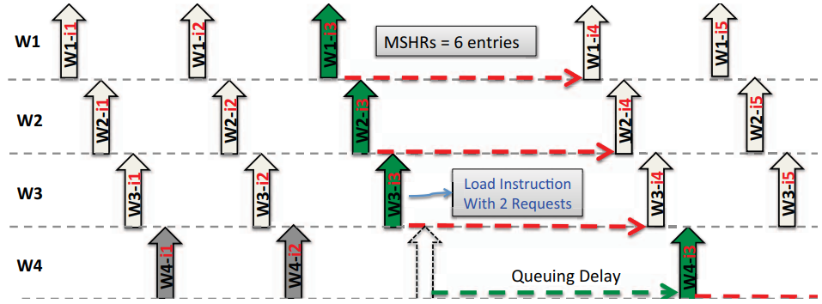
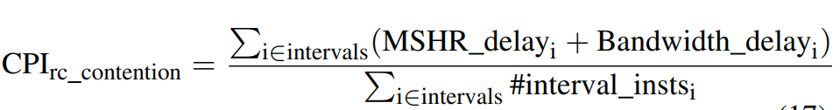
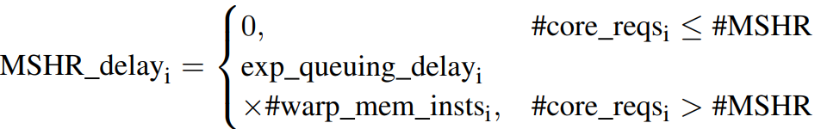
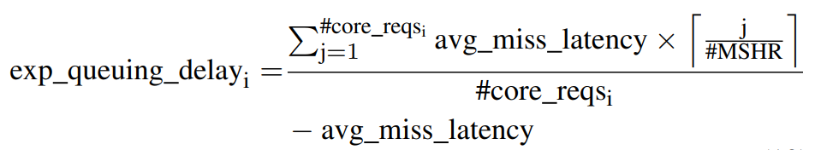
Methodology
Model Workflow
  Multi-warp model: 2) Modeling Resource Contention
    Only model the queuing cycles of MSHRs and DRAM bandwidth
    Modeling MSHRs
      the number of concurrent memory requests of a core in interval i
      the expected latency of a memory request in interval I
        avg miss latency is the average L2/DRAM access latency
23

Slide 24
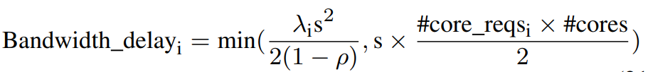

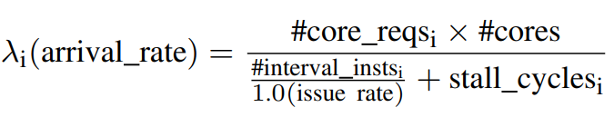
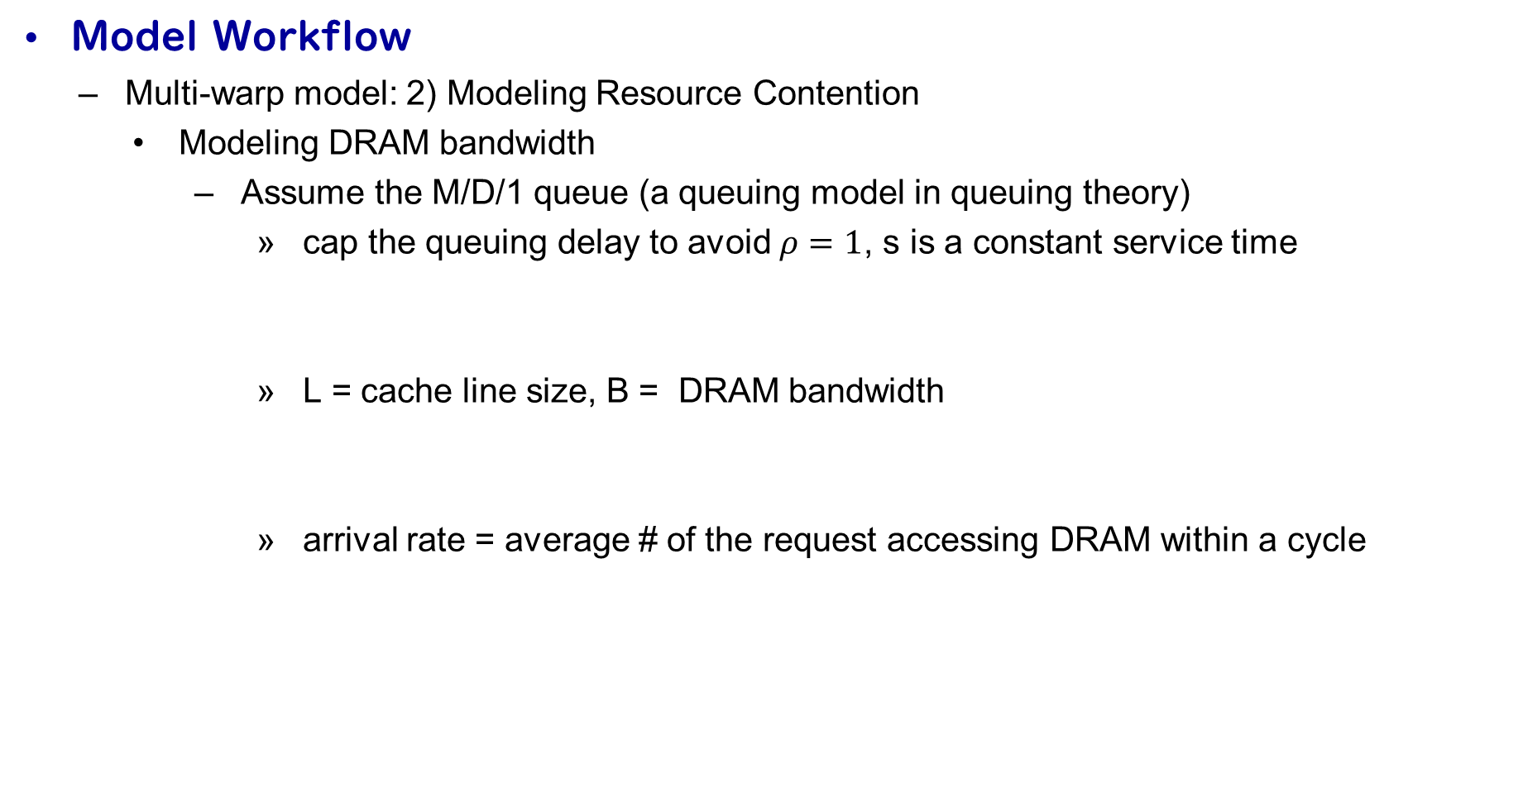
Methodology
Model Workflow
  Multi-warp model: 2) Modeling Resource Contention
    Modeling DRAM bandwidth
      Assume the M/D/1 queue (a queuing model in queuing theory)
        cap the queuing delay to avoid $ρ=1$, s is a constant service time
        L = cache line size, B = DRAM bandwidth
        arrival rate = average # of the request accessing DRAM within a cycle
24

Slide 25
  GPU Background
  Related Work
  My Research: Learning to Simulate
  RL for Arch Research
Contents

Slide 26
Challenges & Opportunity
  Analytical models are fast but require extensive architecture-specific calibration by designers
  Cycle-accurate simulators are prohibitively slow
Can we get an accurate performance model without these problems?
It is the time to leverage the power of deep learning!
26

Slide 27
Overview of My Work
  Learning to Simulate: A Trace-Driven Deep Learning Framework for GPU Performance Modeling
    Goal: replace slow cycle-accurate GPU simulators with a trace-driven, deep learning framework
    Approach: model instruction-level latency using neural network + warp fusion + SM sampling
    Output: accurate kernel runtime predictions in cycles
  Key Contributions
    The first trace-driven, deep learning-based cycle-level GPU performance simulator
    Accurate and efficient simulation across architectures
    A large-scale, diverse dataset for instruction-level GPU modeling
27

Slide 28
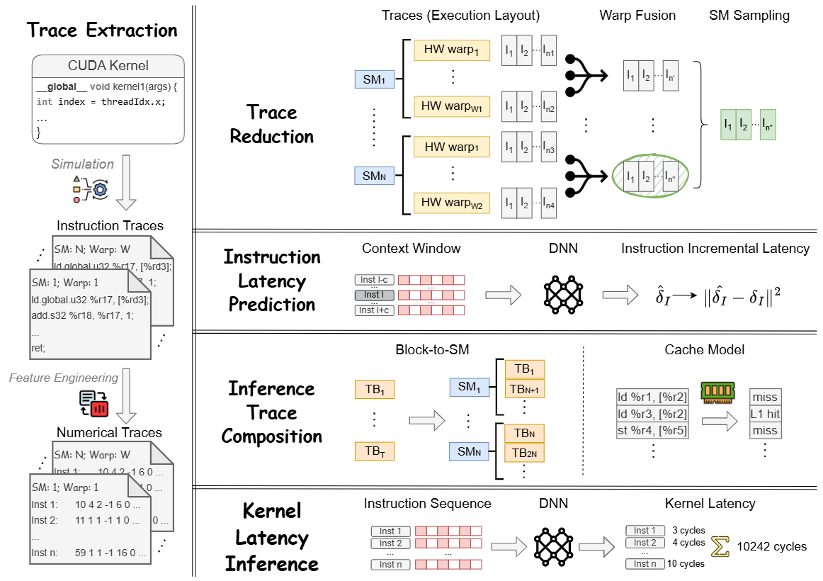

Slide 29
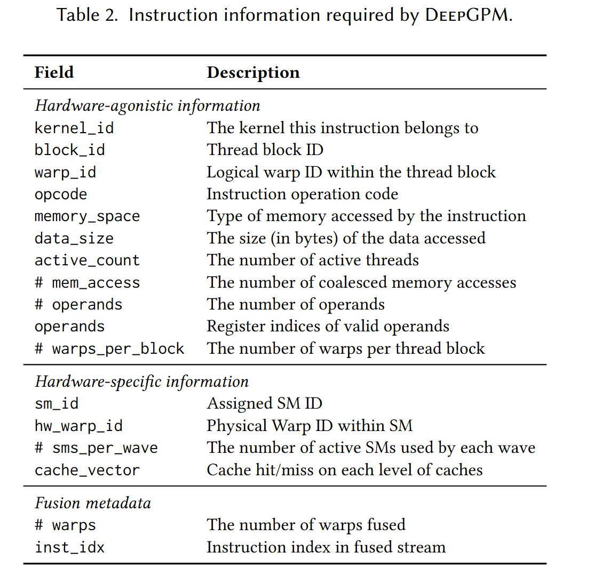
Trace Extraction
  Instrumented GPGPU-Sim
    Get detailed execution events of every instruction
    at every cycle
  Collected Information
    Hardware-agonistic information
      opcode, memory space, active count, operands, …
    Hardware-specific information
      SM id, cache vector, …
  Provides the true latency labels used during
  training
Note: ground-truth traces are only required for training; at inference time, the trace can come from other sources
29

Slide 30
Trace Reduction: Challenges with Raw Traces
  A GPU kernel typically executes at least millions of instructions
    Most warps have similar behaviors
    Branch divergence, block-to-SM scheduling, resource contention, … introduce trace heterogeneity
  Sequence misalignment between training and inference
    We have the exact instruction completion order when training
    This order is unavailable at inference time
  Key Challenge
    How to retain critical execution information while reducing trace size?
    Use the same sequence order for training and inference
30

Slide 31
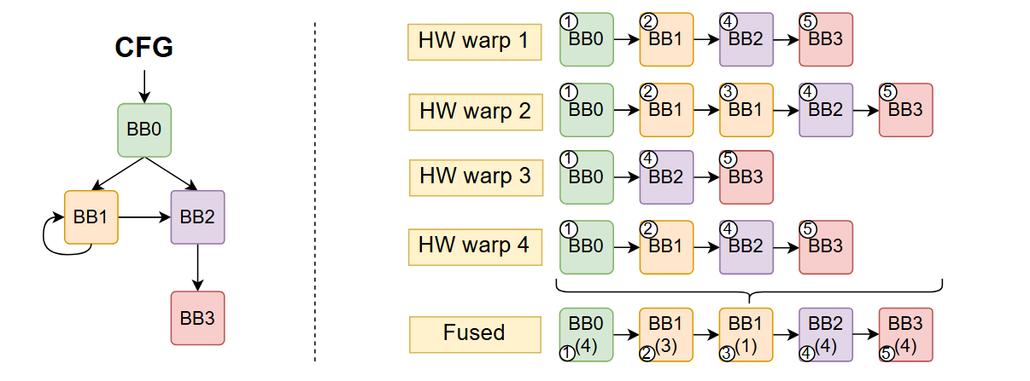
Trace Reduction: Solutions
  Warp Fusion for Intra-SM Efficiency
    Merge warps at basic-block granularity based on CFG
    Preserve divergence blocks but eliminates redundant sequences
    Output: a compact instruction sequence for each SM
31

Slide 32
Trace Reduction: Solutions
  SM Sampling for Inter-SM Efficiency
    Training: select top-k slowest SMs as they dominate kernel latency
    Inference: approximate top-k using instruction count heuristic
    Output: k instruction sequences for a kernel
32

Slide 33
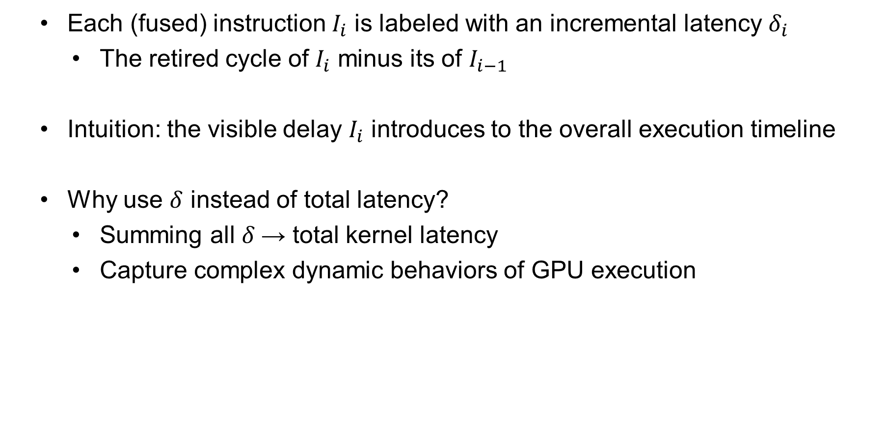
Instruction Latency Prediction: Incremental Latency
  Each (fused) instruction $I_{i}$ is labeled with an incremental latency $δ_{i}$
    The retired cycle of $I_{i}$ minus its of $I_{i−1}$
  Intuition: the visible delay $I_{i}$ introduces to the overall execution timeline
  Why use $δ$ instead of total latency?
    Summing all $δ$→ total kernel latency
    Capture complex dynamic behaviors of GPU execution
33

Slide 34
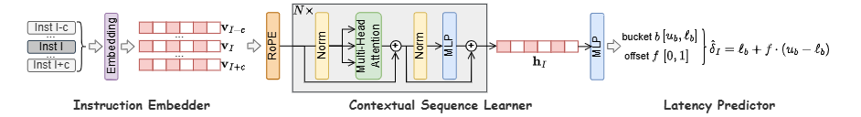
Instruction Latency Prediction: Neural Network Model
  Backbone: Transformer Encoder
    Why? The latency of an instruction is not only related to itself, but also to the instructions executed before it
    Include “future” instructions because, after fusion, an instruction appearing later here may retire earlier in time
  Instruction Embedder
    Handle categorical features
34

Slide 35
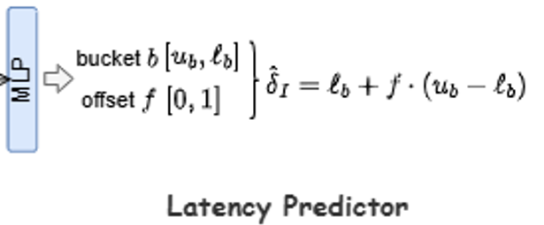
Instruction Latency Prediction: Hybrid Head
  The problem with pure regression
    Instruction latencies span a very wide range
    A small fraction of long-latency instructions dominate overall runtime
  Solution: Combining Classification and Regression
    Classification: predict which latency “bucket”
    Regression: predict an offset within the bucket
  Choose the number of bucket to match GPU instruction characteristics
    short-latency; medium-latency; long-latency; outlier
    ALU operations; L2 cache hits; global memory access; page fault
35

Slide 36
Inference Trace Composition
  During training, traces come from instrumented GPGPU-Sim
    runtime features (hardware scheduling, cache hits/misses)
  During inference, such detailed traces are not available
  We must reconstruct essential runtime behaviors (scheduling, memory behaviors) with lightweight models
36

Slide 37
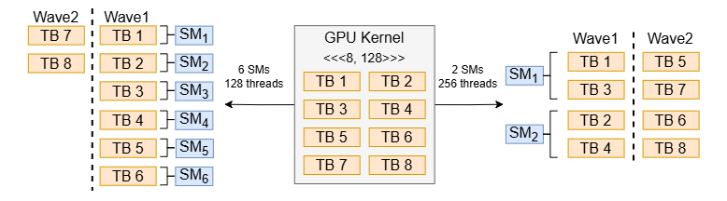
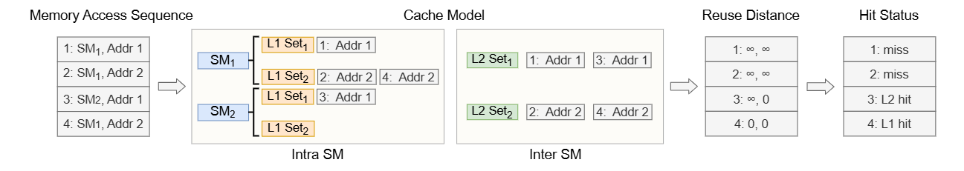
Scheduling & Cache Models
  Block-to-SM Scheduling
    Sequentially distribute thread blocks to SMs in a round-robin manner
  Cache Model (Reuse Distance Based)
    Approximate cache behavior using reuse distance analysis
37

Slide 38
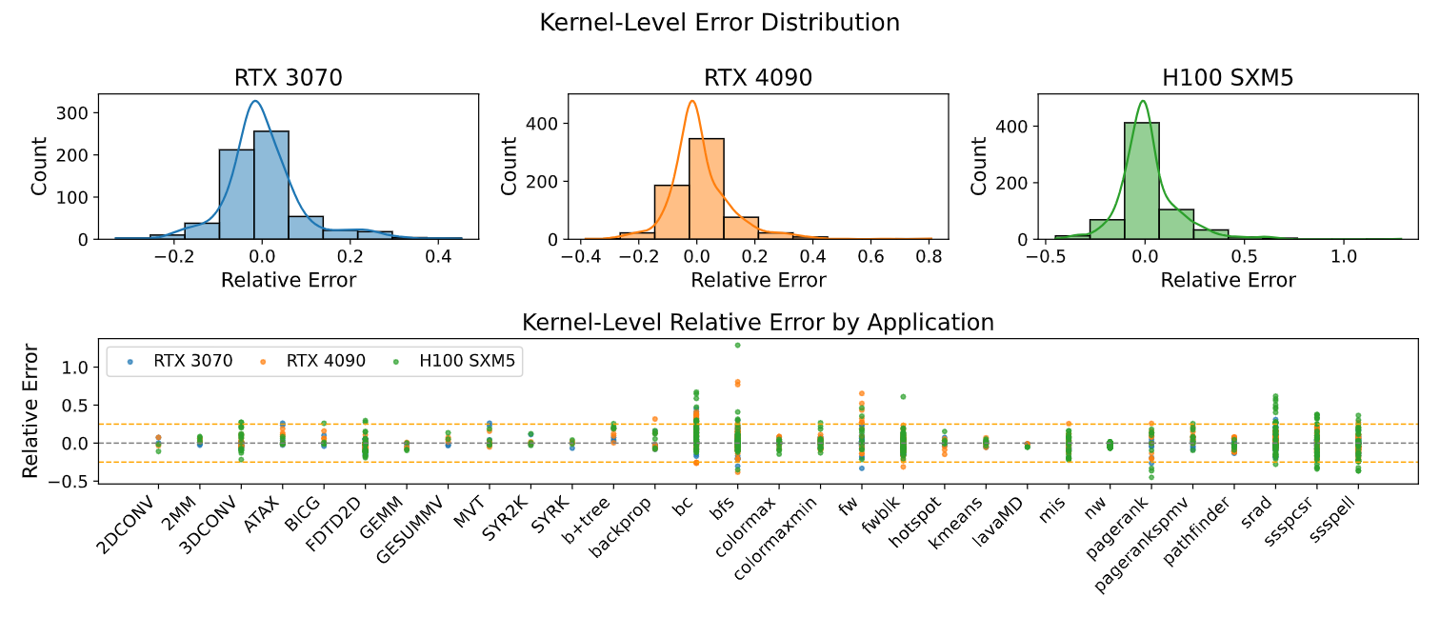
Results: Prediction Accuracy
38

Slide 39
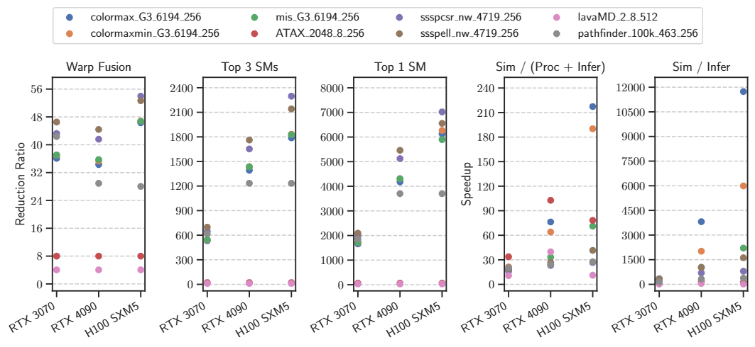
Results: Speedup Over Simulation
39

Slide 40
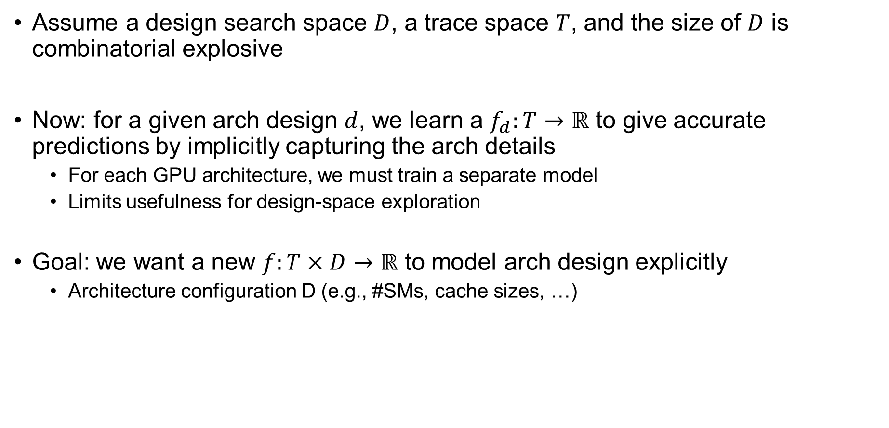
Current Limitation
Assume a design search space $D$, a trace space $T$, and the size of $D$ is combinatorial explosive
Now: for a given arch design $d$, we learn a $f_{d}:T→ℝ$ to give accurate predictions by implicitly capturing the arch details
  For each GPU architecture, we must train a separate model
  Limits usefulness for design-space exploration
Goal: we want a new $f:T×D→ℝ$ to model arch design explicitly
  Architecture configuration D (e.g., #SMs, cache sizes, …)
40

Slide 41
  GPU Background
  Related Work
  My Research: Learning to Simulate
  RL for Arch Research
Contents

Slide 42
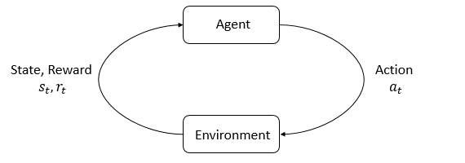
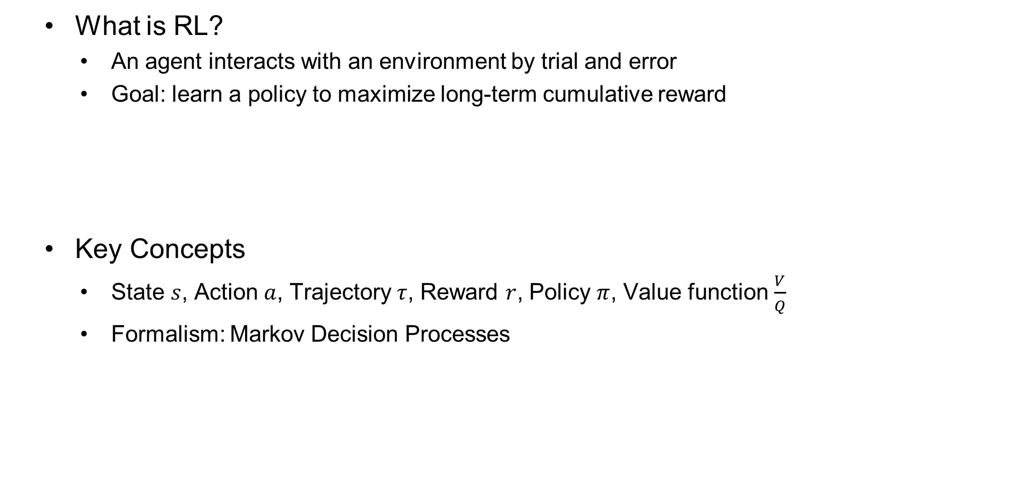
Reinforcement Learning Basics
  What is RL?
    An agent interacts with an environment by trial and error
    Goal: learn a policy to maximize long-term cumulative reward
  Key Concepts
    State $s$, Action $a$, Trajectory $τ$, Reward $r$, Policy $π$, Value function $\frac{V}{Q}$
    Formalism: Markov Decision Processes
42

Slide 43
RL Algorithms Taxonomy
  On-Policy Methods
    Learn from actions taken by the current policy
    “I only trust what I actually tried myself”
    Stable, but less sample-efficient
  Off-Policy Methods
    Learn from data generated by different policies
    “I can also learn by watching others or my old self”
    sample-efficient at the risk of instability
  Model-Free Methods
    Learn directly from rewards without modeling the environment
    “I don’t need to understand the world, I just react to feedback”
  Model-Based Methods
    Learn a predictive model of environment
    “I build a simulator in my head and practice before acting”
43

Slide 44
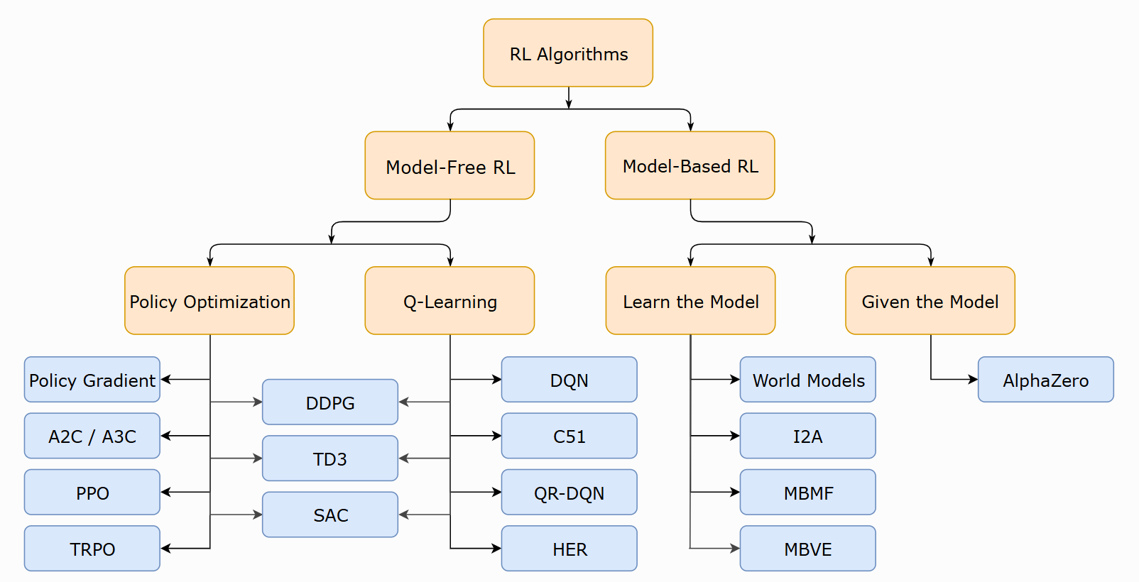

Slide 45
RL for Arch Research
  Scheduling and Resource Management
    Job scheduling, DAG scheduling (DeepRM, Decima, …)
    Cache replacement, bypassing, and prefetching (Pythia, CHROME)
    Policy: the scheduler’s decision (which job or task to run next)
    Reward: job completion time, throughput, cache hit rate, IPC, …
  Design Space Exploration
    DRAM controllers (MARL), Network-on-Chip, Chip Floorplanning (Google)
    Policy: configuration or placement decision
    Reward: performance-per-watt, latency, wirelength, …
45

Slide 46
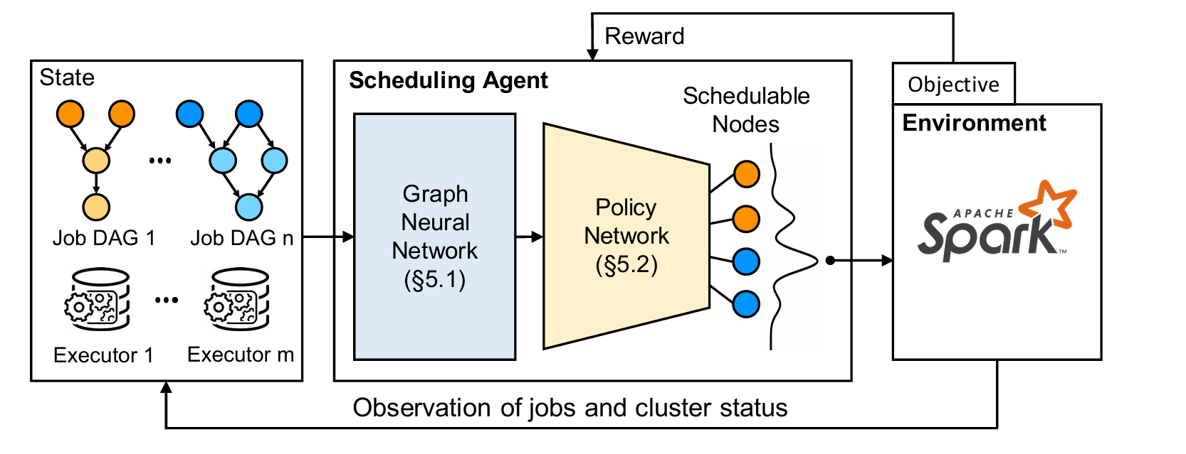
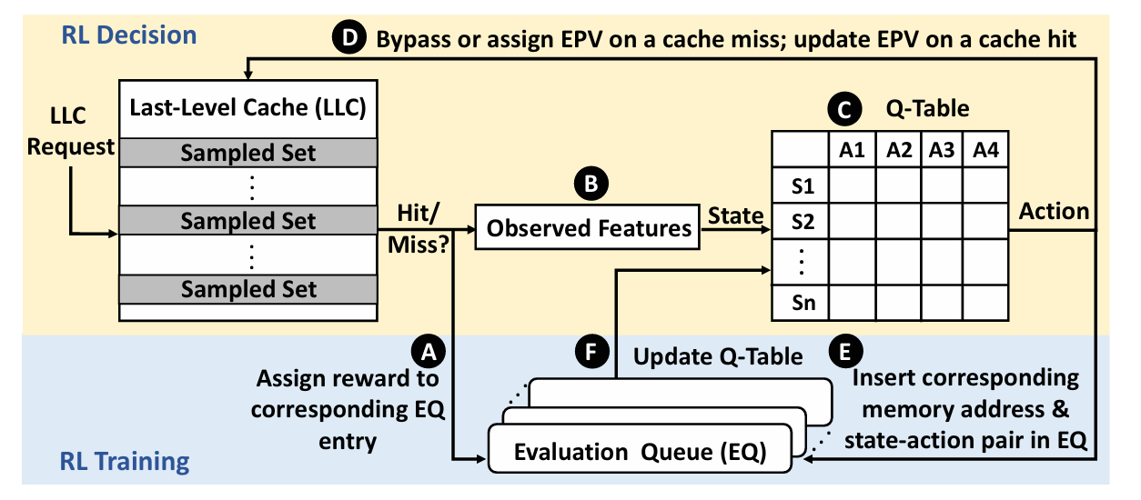

Slide 47
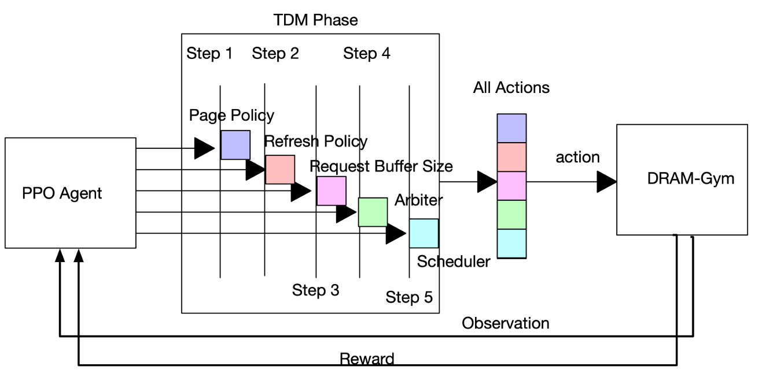
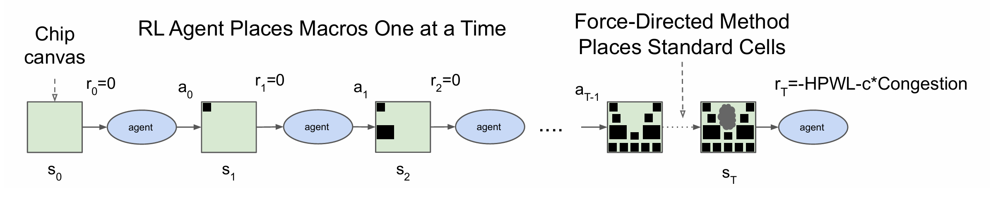

Slide 48
Q & A
Notes:
That’s all. Thanks for the listening.

